Slide 1
Income Tax Planning
MyFRS
FINANCIAL GUIDANCE PROGRAM

Slide 2
The Reasons We Are Here
Review and understand federal tax form 1040
Recognize opportunities to reduce and manage your taxes throughout the year
Identify tax planning opportunities to help accomplish your financial goals
Learn to use the tools and resources available to you
Know which steps to take next

Slide 3




Tools and Resources
MyFRS.com
MyFRS Financial Guidance Line
866-446-9377
Employee workshops
Print and e-mail communications

Slide 4


Personal Action Plan
Action Steps | Done
See Appendix G for your own Personal Action Plan

Slide 5
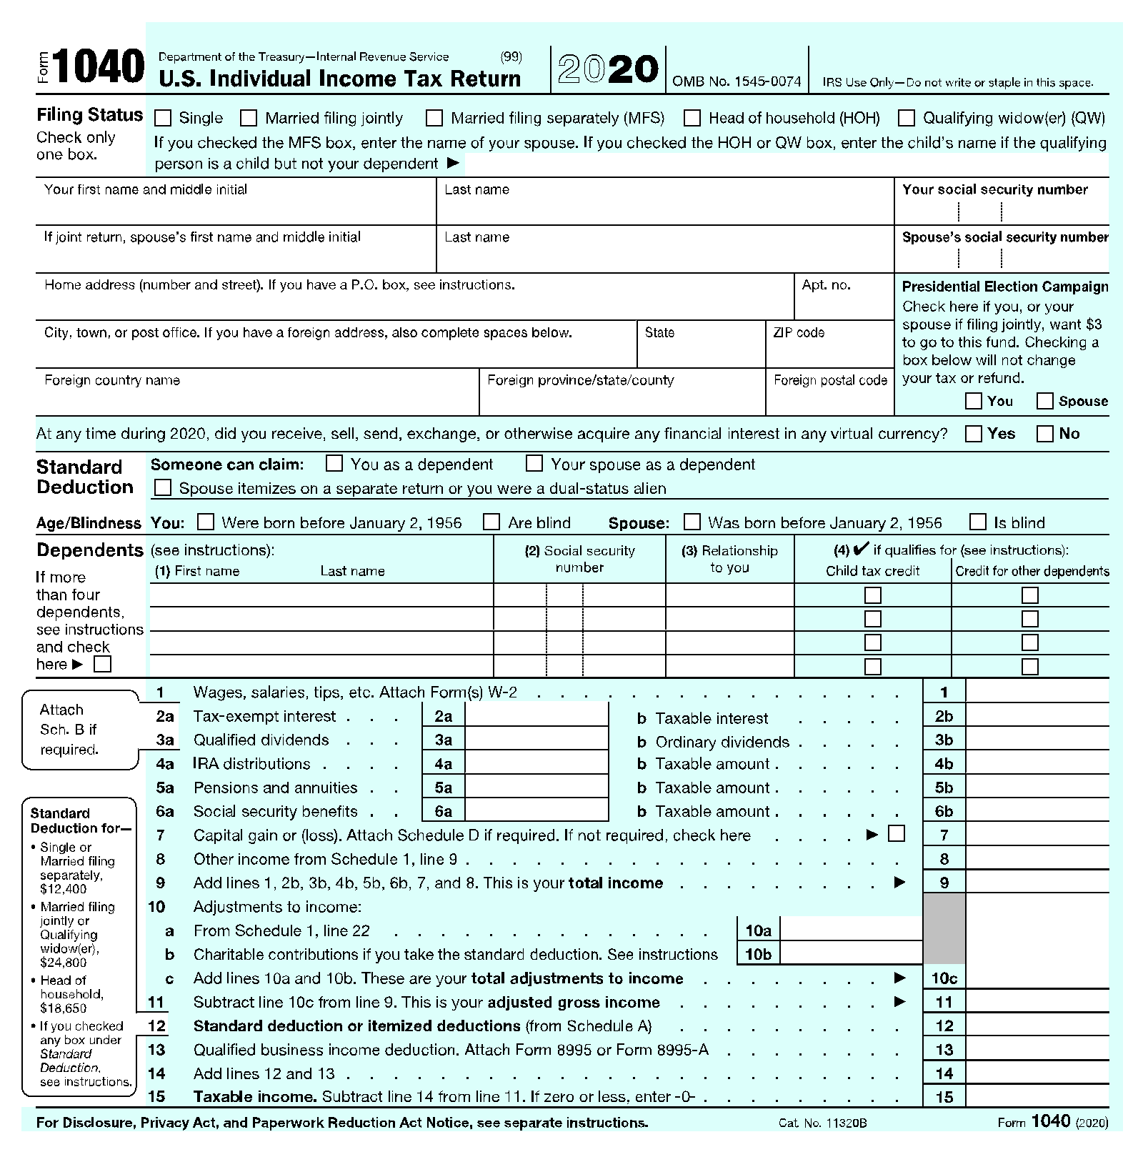
Federal Tax Form 1040

Slide 6
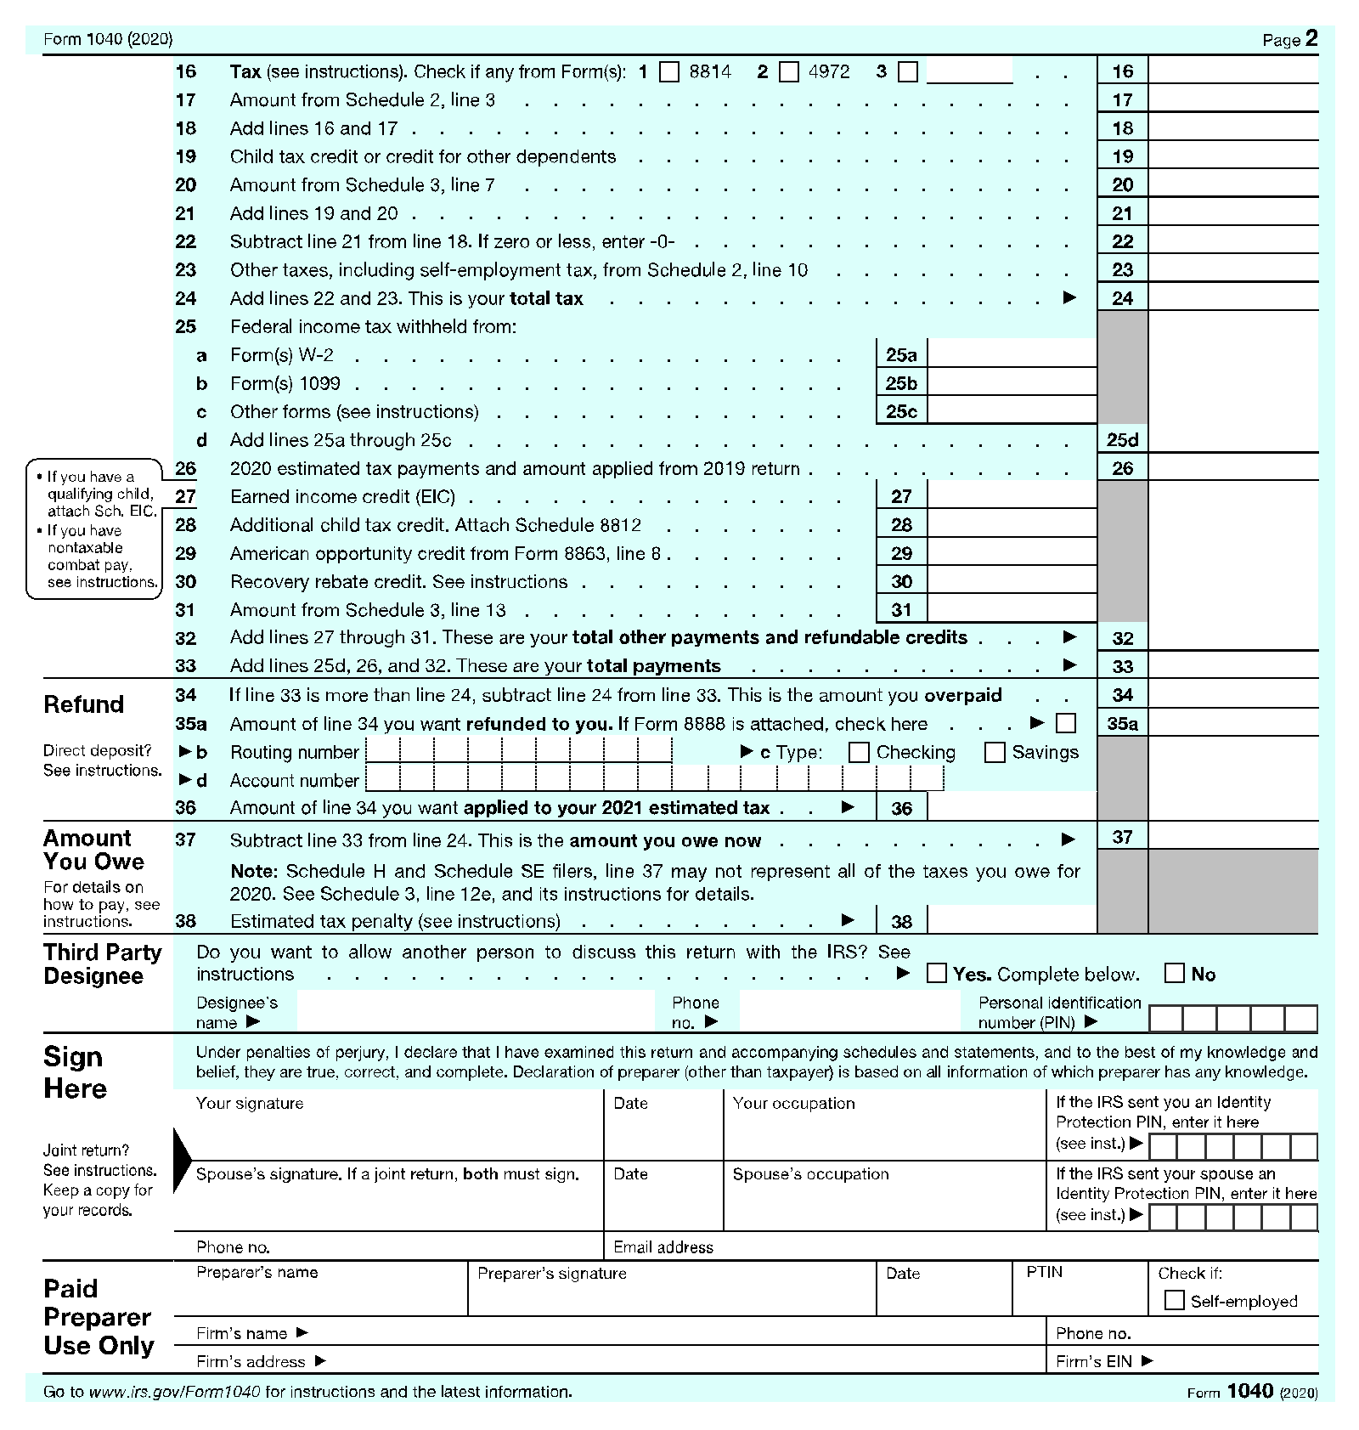
Federal Tax Form 1040
See Appendix B for form 1040

Slide 7
Federal Tax Calculation
Part 1
- | Gross Income Adjustments
= - | Adjusted Gross Income (AGI) Standard/Itemized Deductions
= | Taxable Income

Slide 8
Federal Tax Calculation
Part 2
x | Taxable Income Tax Rates from Tables
= + - - | Income Tax Due Other Taxes Tax Credits Withholdings/Estimated Payments
= | Net Tax Due/Income Tax Refund

Slide 9
2021 Standard Deductions
Filing Status | Standard Deduction
Single | $12,550
Married Filing Jointly (MFJ) | $25,100
Married Filing Separately (MFS) | $12,550
Head of Household | $18,800
Note: An additional standard deduction for elderly or blind taxpayers is also available

Slide 10
Itemized Deductions
Mortgage interest expense
State, local, and real estate taxes
Charitable contributions
Medical and dental expenses
Investment interest expense
See Appendix C for Schedule A

Slide 11
2021 Tax Rates
 | Married Filing Jointly (MFJ) | Single
10% | $0 - $19,900 | $0 - $9,950
12% | $19,901 - $81,050 | $9,951 - $40,525
22% | $81,051 - $172,750 | $40,526 - $86,375
24% | $172,751 - $329,850 | $86,376 - $164,925
32% | $329,851 - $418,850 | $164,926 - $209,425
35% | $418,851 - $628,300 | $209,426 - $523,600
37% | $628,301 + | $523,601 +

Slide 12
Changing Tax Rates
Tax Year | Tax Rates
2013-2017 | 10% | 15% | 25% | 28% | 33% | 35% | 39.6%
2018-2025 | 10% | 12% | 22% | 24% | 32% | 35% | 37%
2026+ | 10% | 15% | 25% | 28% | 33% | 35% | 39.6%
Recognize your current and future potential marginal tax bracket when making financial planning decisions

Slide 13
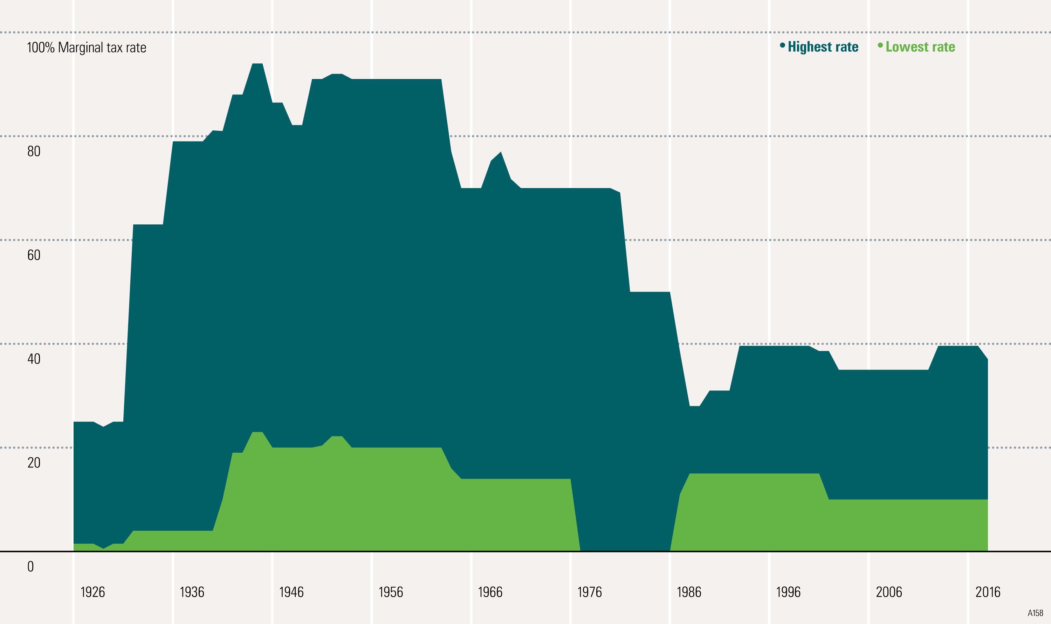
Comparison of Highest and Lowest Marginal Tax Rates
© Morningstar. All Rights Reserved.

Slide 14
Which is Better?
A. $500 Tax Deduction
B. $500 Tax Credit

Slide 15
Family-Based Credits
Child tax credit
  $2,000 credit per eligible child
  $500 credit per eligible non-child
  Reduced if AGI (Adjusted Gross Income) is over a certain threshold
Dependent care tax credit
  Credit ranges from 35% - 20% of AGI (Adjusted Gross Income)
  When AGI > $43,000 → 20%
  Maximum expenses considered:
    $3,000 (one child)
    $6,000 (two or more children)
See IRS Publications 972 and 503 for more information

Slide 16
Key Strategies in Tax Planning
Defer
Defer
Shift
Shift
Deduct
Exclude
Comply

Slide 17
Key Strategies in Tax Planning
Defer
Defer
Shift
Shift
Deduct
Exclude
Comply

Slide 18
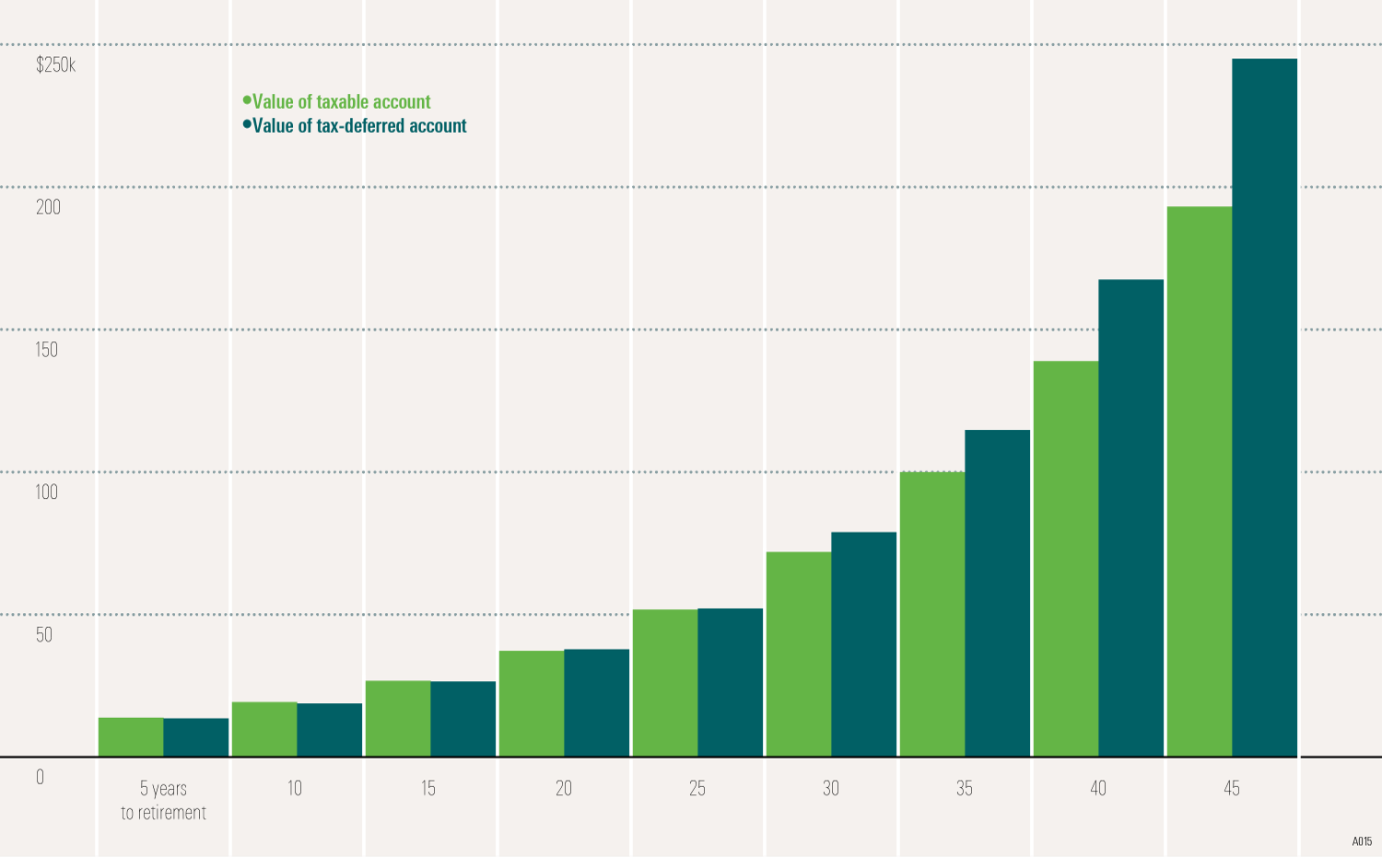
Benefits of Deferring Taxes
Hypothetical value of $10,000 invested in stocks. This example is for an investor in the 28% bracket using the 2019 tax code. Assumes an 8% annual total return. Estimates are not guaranteed. This is for illustrative purposes only and not indicative of any investment. © Morningstar. All Rights Reserved.

Slide 19
Tax Deferral Opportunities
Tax-Deferred Savings Vehicles
403(b), 457, 401(k) Plans
Individual Retirement Accounts (IRAs)
Other-Tax Deferred Savings Plans
Annuities
Call the MyFRS Financial Guidance Line to discuss retirement saving opportunities

Slide 20
2021 Maximum Contribution Limits (403(b), 457, 401(k))
 | 457 Plan – Deferred Comp | 403(b) Plan – Tax-Sheltered Annuity | 401(k) Plan
Contribution Limits | $19,500
Catch-Up Contributions | Additional contributions allowed if you are 50 and older. Each plan has other “special catch-up” rules based on the time until retirement or length of service. |  | $6,500
Contact your plan administrator to see if you qualify for special catch-up contributions

Slide 21
Traditional IRA
Tax-deferred growth
Possible current deduction defers the tax on the contribution amount
Deduction is taken on page one of the 1040 – no need to itemize
Contributions can be made until April 15th of the following year
2021 contribution limits are $6,000; $7,000 if age 50 or older
Income limits for deductibility

Slide 22
2021 Traditional IRA
Deductibility of Contributions
If an Active Participant in a Retirement Plan, IRA Deductibility Depends on AGI
Single or Head of Household
Married Filing Jointly (MFJ)*
Non-Deductible
Non-Deductible
$76,000
$125,000
$66,000
$105,000
Deductible
Deductible
*These MFJ limits apply when BOTH are active participants in a retirement plan

Slide 23
Key Strategies in Tax Planning
Defer
Defer
Shift
Shift
Deduct
Exclude
Comply

Slide 24
Taxable Income
Defer Income
Monday January 3, 2022
Accelerate Deductions
Friday December 31, 2021
Depending on the changing tax laws and your own situation, it may be more advantageous to accelerate income and defer deductions

Slide 25
Capital Gains
Short-Term
  Investment held one year or less
  Gain is taxed at ordinary income tax rates
Long-Term
  Investment held more than one year
  Gain is taxed at lower capital gains rates (0%, 15%, or 20%)

Slide 26
Key Strategies in Tax Planning
Defer
Defer
Shift
Shift
Deduct
Exclude
Comply

Slide 27
Itemized Deductions: Mortgage Interest
Interest is fully deductible on:
  Mortgages prior to 10/13/87
  Mortgages from 10/14/87-12/15/17 up to $1,000,000
  Mortgages after 12/15/17 up to $750,000
Loan must be secured by a principal or second home owned by you
Cannot be for more than the home’s current fair market value
Call the MyFRS Financial Guidance Line or see IRS Publication 936 for more information

Slide 28
Itemized Deductions: Taxes
Limited to $10,000
General rules for deducting taxes:
  The tax must be imposed on you
  The tax must be paid during your tax year
State & local income taxes
  Includes withholdings, estimated payments, refunds credited, and payments with your return
Real estate taxes
  Based on the assessed value of the real property

Slide 29
Maximize Itemized Deductions
Consider prepaying taxes: Real estate, state and local
Document charitable contributions: Cash property
“Bunch” in one year other deductions: Medical/dental (7.5%)
Consider in which year it is better to pay your real estate taxes
Consider bunching expenses or donations into one year

Slide 30
Key Strategies in Tax Planning
Defer
Defer
Shift
Shift
Deduct
Exclude
Comply

Slide 31
Roth IRA
Tax-free savings vehicle
  Provides no tax deduction upon contribution
Tax-free distributions
  Account established for 5 tax years, and
    First-time home purchase
    Death or disability
    After age 59½
You can withdraw your contributed principal without tax or penalty at any time

Slide 32
Roth IRA Contributions
Eligibility Phase-Out
  Single: $125,000 - $140,000
  MFJ: $198,000 - $208,000
Contributions can be made until April 15 of the following year
2021 contribution limits are $6,000; $7,000 if age 50 or older
Call the MyFRS Financial Guidance Line or review IRS Publication 590 for more information

Slide 33
Roth IRA Conversion
Ordinary income tax on pre-tax contributions and earnings
Considerations:
  Tax rate at time of conversion and at distribution
  Ability to pay taxes from other sources
  Other sources of retirement income
  Number of years you will allow the Roth IRA to grow

Slide 34
Coverdell Education Savings Account
Tax-free savings vehicle for education
Tax-free distributions for qualified higher education expenses
  Tax and penalties apply if not used for qualified education expenses
$2,000 contribution limit per year per beneficiary
Call the MyFRS Financial Guidance Line or review IRS Publication 970 for more information

Slide 35
Section 529 Plans
Contributions are after-tax
Growth is tax-deferred
Distributions are tax-free if used for qualified education expenses
  State tax-free status varies by state plan
Donors not subject to income limitations
Tax and penalties apply if not used for qualified education expenses
In 2021, you can contribute $15,000 ($30,000 married) per beneficiary per year without triggering gift tax

Slide 36
Home Sale Exclusion
Capital gains exclusion conditions:
  Owned home two of last five years
  Lived in home two of last five years
  Have not used the exclusion in two-year period ending on sale date
Exclusion Amount
  Single $250,000
  Married $500,000 (if both meet the “lived-in-it” and “have-not-used” requirements; otherwise $250,000)

Slide 37
Key Strategies in Tax Planning
Defer
Defer
Shift
Shift
Deduct
Exclude
Comply

Slide 38
Complying: Documentation and Recordkeeping
Social Security numbers for dependents
Itemized deductions
Cost basis of capital assets
Non-deductible IRAs
Withholding requirement

Slide 39
Pros and Cons of Receiving a Tax Refund
Pros
A method of forced saving
Lump sum payment available for goals
  Funding IRA
  Vacation
Makes you feel like you “did a good job” preparing your tax return
Cons
Reduces your monthly cash flow
Could be used more effectively during the year
  Pay down debts
Lost opportunity to earn interest
Consider the size of the refund (if any) you would like to receive

Slide 40
Withholding Safe Harbor
To avoid the underpayment penalty, you must withhold the lesser of:
  90% of the tax shown on the 2021 return
  100% of the tax shown on the 2020 tax return
    110% if 2020 AGI was over $150,000 filing Single/MFJ or $75,000 MFS
  Penalty does not apply if tax due is less than $1,000

Slide 41
How Do You Pay Your Taxes?
W-4 withholding
  Withholding amount based on the W-4 you submit
Mandatory withholding
  20% on distributions from employer plans (IP, 403(b), 457,401(k)...)
Estimated quarterly payments
  For those with income sources not subject to withholding, or who may be subject to the underpayment penalty
Balance due when filing tax return
  Check / Credit Card

Slide 42
What Determines Withholding Using the Redesigned Form W-4?
Filing status
Multiple jobs or spousal employment
Child tax credit
Other adjustments
  Other income (not from jobs)
  Itemized deductions
  Extra withholding
See Appendix D for W-4

Slide 43
Updating Your W-4
Any time your filing status, deductions, or credits change
  Marriage/divorce, birth/death
Increase/decrease in income
Contact your payroll department (or visit irs.gov) to obtain form W-4
Tax Withholding Estimator and worksheets available to assist with appropriate withholding
Submit your updated W-4 to your payroll department
If you last submitted a W-4 prior to 2020, consider submitting a new W-4 for more accurate tax withholding

Slide 44

Additional Tax Considerations
The Importance of Saving AND Investing

Slide 45
Tax Planning Techniques for Life Events
Getting married or divorced:
  New filing status
  Phase-outs
  Withholdings
Gaining or losing dependents:
  New filing status
  Tax credits
  Withholdings
Purchasing a home
  Itemized deductions
  Withholdings

Slide 46
How Do You Avoid the 10% Penalty on Retirement Plan Distributions?
Distributions From: | Some Exceptions to the 10% Penalty:
FRS Plans 403(b)/401(k) Plans | Separate from service in the year of or after turning age 55
IRAs | Qualified higher education expenses Qualified first-time homebuyer distribution
FRS Plans 403(b)/401(k) Plans IRAs | Distributions at or after age 59 ½ Distributions because of: Medical expenses (over 10% of AGI) Disability Death Distributions calculated by using Substantially Equal Periodic Payments Qualified birth/adoption costs

Slide 47
Tools and Resources
MyFRS.com
MyFRS Financial Guidance Line
866-446-9377
Employee workshops
Print and e-mail communications

Slide 48
Next Steps: Personal Action Plan
Action Steps | Done
Determine your financial goals
Review your most recent tax returns
Identify opportunities to reduce your taxes that are in line with your goals
Project your taxes and withhold properly
Call the MyFRS Financial Guidance Line at 1-866-44-MyFRS

Slide 49

Questions and Answers

Slide 50
Income Tax Planning
MyFRS
FINANCIAL GUIDANCE PROGRAM

