Slide 1
Human Resources Liaison Network November 14, 2017

Slide 2
Welcome to the HR Liaison Network Meeting November 14, 2017

Slide 3
Shelia Daniels, Executive Director UCF Human Resources Welcome

Slide 4
Maureen Binder, CHRO and Assoc. Vice President Human Resources HR – 2018 and Beyond

Slide 5
2017 Looking Back
SUS HR Conference
New EAP Provider - Health Advocate
Labor Contracts: AFSCME, PBA
Strategic Plan
Thousands of ePAFs (20K)
PageUp Contract/ Kickoff
45th Annual Awards Program (600 attendees)
Executive Order Compliance/ Sick Leave
2017 Benefits Fair (1,600 employees)
HR Learning Rebuild
Leadership Development Programs
Various PeopleSoft updates
Financial Wellness Series

Slide 6
2018 Looking Ahead
UCF Downtown
Class & Comp Project
PageUp Project Implementation
Background Check Policy
Exit Interviews
HR Compliance
HR Liaison Training Curriculum
Communications Coordinator
HR Structure Evolution
Rebranding HR
ORC-HR
Minimum Wage Inc $8.10 to $8.25
FMLA/ADA Analysis
Time & Labor
UCF Hospital

Slide 7
Maureen Binder
Associate Vice President for Human Resources &
Chief HR Officer
Organizational Chart
Renee Grigor
Assistant Director
Talent Acquisition
Sarah Lovel
Assistant Director
Compensation
Douglas Lewis
Associate Director
Facilities & Safety
Nancy Gayton
Associate Director
Health Affairs & COM
Becky Moulton
Director
Workforce Administration & Technology
Shelia Daniels
Executive Director
Elizabeth Richner
Assistant to CHRO
Millicent Downer
Associate Director
HR Accounting & Operations
Michelle Brooks
Associate Director
Employee Relations &
HR Compliance
Shanika Gooding
Marie Milien
Amy Robinson
Consultants
Carol Arce
TBA
Tajah Foster OPS
HR Representatives
Tony Fappiano
Julia Needham
Consultants
Kristina Smith
Josh Hallam
Analysts
Kay West
Sr.HR Representative
Ashlynn Hughes
Intern
Tania Gutierrez-Catasus
Cristina Rever
Farrah Torres
Annie Brown
Cassetta Phillips
Coordinators
Liz Harris
Stephanie Santiago
HR Assistants
Floyd Sturdifen
Lead Coordinator
Tara Herget
Office Manager
Danielle Chung
Annya Baerga
Brittany Hofmann
Coordinators
Ashley Longoria
Associate Director
Benefits & Leave Administration
Deborah Frankenbach
Senior HR Representative
Elizabeth Rivera
Senior Secretary
Katheryn Daniels
Theresa Scipione
Accounting Coordinators
Ivette Martinez
Accountant
Elizabeth Herrera
Employee Relations Coordinator
Terri Smith
Assistant Director HRIS
Daren Hill
Monica Alvarado-Rodriguez
Molly Myers
Jamie Makowski
Senior Analysts
TBA
IT Manager
Aisha Morfe-Benscome
Assistant Manager
Keven Ayala
Samuel Ensenat
Emanuel Torres
Venessa Williams
Benefits Coordinators
Jon Richman
Benefits Analyst
Isha Guerrero-Londeree
Assistant Director
Payroll Services
Ben Anderson
Assistant Director, Leave Administration
Maribeth Kerr
Assistant Manager
Michael Minutelli
LaToya Anderson
Michael Lieblong
Jordan Castillo
Jeremy Armstrong
QC Coordinators
Bonnie Belot
Senior HR Representative
Lizbed Santiago-Rivera
Alicia Melendez
Leave Coordinators
Todd Coon
HR Representative
Rachelle Lehner
Assistant Director
Learning & Organizational Effectiveness
Abbee Camen
Assistant Director,
Employment Services & Records
Lee Williams
Training Coordinator
Margie Chusmir
OD Consultant
Andrew Carlton
Intern
Garnette Garricks
Assistant Manager
Kelly Fernandez
Tia Lloyd
HR Coordinators
Fiona M. Murphy
Lorena Perez
Connie Gauthreaux
Karen Sgambati
HR Representatives
Karen Black
Shay Vickers
Program Assistants
TBA
Sr. HR Communications Coordinator
TBA
Associate Director
Research & Commercialization
Jennifer McKay
HR Recruiter
Karen Norum
Web Designer
Doshie Walker
Training Manager
Last updated: 10/02/2017

Slide 8
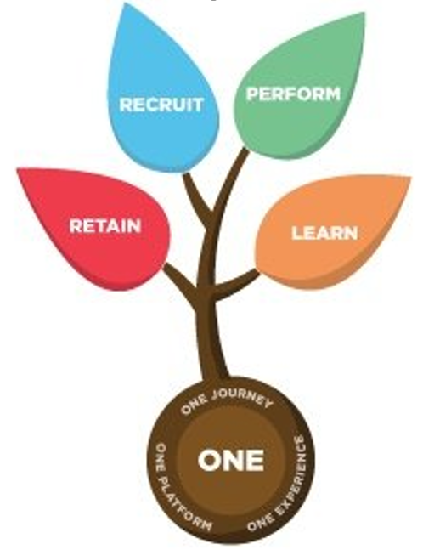
Recruitment management
Onboarding
Performance management
Data and reporting

Slide 9
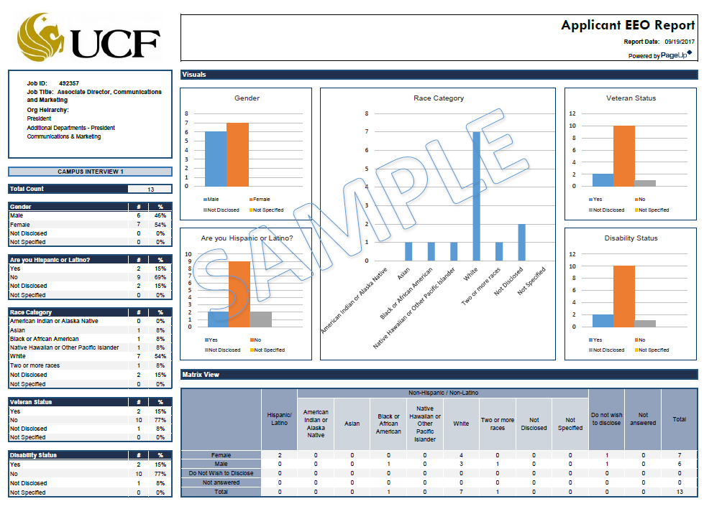

Slide 10
Classification & Compensation Update

Slide 11
UCF Classification & Compensation Study
The grey shading below indicates points where we involve various UCF stakeholders:
 |  | HR | Leadership | CPAG | Job Family Experts | All UCF Staff
1 | Establish Compensation Philosophy
2 | Determine Job Architecture, Including Job Families and Career-Leveling Frameworks
3 | Determine Job Titles, Collect Position Descriptions, and Map Employees to Jobs
4 | Conduct Market Competitiveness Assessment and Update Job Descriptions to Reflect Current Jobs
5 | Develop Salary Structure and Job Evaluation System
6 | Develop Pay Guidelines
7 | Communicate and Plan for Implementation
Notes:
The class & comp project has officially entered into phase three of the project. This phase is the center and most time consuming part of the entire project.
The project team has 29 meetings scheduled with Deans, VPs, Leaders, and main HR contacts throughout the month of November.
Beginning next week, employees will receive an email from compproject@ucf.edu with the position description tool.
The emails will dispatch by job families with the last group going out before the end of December.
If you haven’t heard anything by the middle of December on what to expect from this project, please contact your main College/Division HR person.

Slide 12
New HR Liaison Training

Slide 13
Questions?

Slide 14
Rhonda Bishop and Christina Serra, Compliance, Ethics and Risk Office ucf code of conduct

Slide 15
Employee Code of Conduct

Slide 16
Cindy Persico, Health Advocate Ucf Employee assistance program

Slide 17
EAP+Work/Life Training Seminar
Orientation to EAP and
Work/ Life Service

Slide 18
EAP+Work/Life Program Features
24/7, unlimited telephone access
In-person assessments
Unlimited HR and management consultations
Employee wellness and prevention seminars
Critical incident debriefings
Medical Bill Saver service
Video counseling
Notes:
-

Slide 19
Work/Life Support
Work/Life Specialists find support services and local resources to help with:
Eldercare, childcare
Legal concerns
Financial issues
Time management
Relocation issues

Slide 20
Employee Assistance Program (EAP)
Short-term problem resolution with Licensed Professional Counselors for help addressing a wide range of issues:
Stress; depression; anxiety
Marital problems; family/parenting issues
Work conflicts
Anger, grief and loss; substance abuse
Provides referrals for more long-term support

Slide 21
Employee Benefit
Benefit provided by your employer or plan sponsor that covers
employee
spouse/domestic partner
children
parents and parents in-law
No cost to employee
Strictly confidential

Slide 22
How Can Health Advocate Help?
Family issues
Stress management
Emotional difficulties
Work/Life services
Addictions
Life transitions
Relationship issues
Workplace difficulties

Slide 23
Staff Qualifications
Health Advocate counselors are:
Licensed Social Workers
Licensed Psychologists
Licensed Family and Marriage
Certified CEAP
Certified CAC
Certified Family & Marriage

Slide 24
Let’s Connect
For more information visit us on the web:
HealthAdvocate.com/members

Slide 25
Matt Verdecchia, Senior Trainer/OD for Health Advocate Guest Speaker

Slide 26
Disrespect vs. Harassment
Where is the Line?

Slide 27
What specific services are provided by the EAP?
24 hour access; telephonic or website
Telephonic or In-person assessments
Leadership Assistance
Work/Life Services:
legal, financial, child & elder care services
800.343.2186

Slide 28
Introduction
“We work in the environment we create and…tolerate.”
Every employee has the right to work in a respectful workplace.
Every employee therefore has the responsibility to help create and maintain that culture.
The following program identifies behaviors, differences (some protected under Title VII and other guidelines) stereotypes and cultures that improve or detract from our culture and impact others behavior, morale and productivity.
The goal is to establish a culture of professionalism, civility, inclusion and respect.
Reinforce that all employees are in control of their behavior and therefore responsible and held accountable

Slide 29
Overview
Defining Terms
“Respect”
“Harassment”
Micro-aggressions
Bias
“Reasonable”
Drawing the Line
Expectations
Culture
Training
Resources

Slide 30
Goal
Identify
Stop
Prevent

Slide 31
The Interpersonal “Stew”
Workplaces have collective emotional “atmospheres”
Each of us puts “ingredients” into this “stew” through our actions
Impacts:
Morale
Productivity
Performance

Slide 32
Thin or Thick Skinned?
Thin Thick
Sensitive Non-Sensitive
Reactive Non-Reactive
Aware Not Aware
0 1 2 3 4 5 6 7 8 9 10

Slide 33
What is Inappropriate and Disrespectful Conduct
Harassment/Discrimination (Protected Classes)
Race
Religion
National Origin
Sex
Age
Disability
Military status
Sexual Orientation
Harassment occurs because of WHAT a person is

Slide 34
What is Inappropriate and Disrespectful Conduct
Disrespect- Lack of consideration or regard for co-workers.
Including:
Privacy
Physical space
Belongings
Viewpoints
Philosophies
Beliefs and personalities
Generally NOT DIRECTED at particular individual

Slide 35
What is Inappropriate and Disrespectful Conduct
Bullying- Lateral Violence:
Repeated, unreasonable actions of individual(s) directed toward an employee(s) intended to intimidate or humiliate.
Persistent attacks which focus on the person, rather than constructively critiquing the task or work of employee.
Power and control-assertion of power through aggression
Intentional behavior with expected outcome to denigrate and exclude. Driven by perpetrators NEED to control.
Very similar to Domestic Violence. Keep victim off balance.
Abuser inflicts pain when and where they choose-Keeping the target off balance, not knowing when violence can happen, but hoping for peace and safety.
Bullying occurs because of WHO a person is

Slide 36
Why Victims Do Not Speak Out
Fear of loss of job opportunities
Fear of rejection by co-workers
Fear of being labeled a “trouble-maker” or a “feminist”
Fear of not being considered a “team player”

Slide 37
Why Victims Do Not Speak Out
Fear of being accused of not having a “sense of humor”
Fear of the “rumor mill”
Fear of being labeled “over-sensitive” or “mentally unstable”

Slide 38
Why Victims Do Not Speak Out
Fear of not being believed
Fear of being “wrong”

Slide 39
High Costs

Slide 40
Harassment History & The Law
Title VII, Pub. L. 88-352, 78 Stat. 253
(42 U.S.C. 2000e et seq.)
A. Quid Pro Quo
B. Hostile Environment
C. Prevention

Slide 41
What’s the Motive?
Power
Control
Bullying

Slide 42
Liability Rests With Management
An employer is generally responsible for its’ acts and those of its’ agents and supervisory employees (only those who are in an actual position to significantly affect* the employee’s terms and conditions of employment) with respect to harassment regardless of whether the specific act complained of was authorized or even forbidden by the employer, and often regardless of whether the employer knew or should have known of its occurrence.
*"sig­nificant change in employment status, such as hiring, firing, failing to promote, reassignment with significantly different responsibilities, or a decision causing a signifi­cant change in benefits."

Slide 43
Liability Rests With Management
An employer is generally responsible for its’ acts and those of its’ agents and supervisory employees with respect to harassment regardless of whether the specific act complained of was authorized or even forbidden by the employer, and often regardless of whether the employer knew or should have known of its occurrence.

Slide 44
Management Responsibility
Inform their organizations about this policy
Properly investigate claimed violations
Give careful consideration to the confidentiality of the information
Communicate that reprisal toward affected individuals will not be tolerated
Take appropriate action when the policy is violated up to and including termination

Slide 45
Stopping Harassment Is Part Of Your Job
Because so many legal actions result from mishandling of complaints by supervisors or other “agents” of the employer, it is vital that every manager use every means possible to handle complaints effectively within the organization.

Slide 46
Top Mistakes Managers Make
Trying to resolve complaints personally
Ignoring a complaint
Not taking it seriously
Not taking action

Slide 47
Manager’s Role in Promoting Respect
Be self-aware: Monitor your behavior to role model respect and inclusion of co-workers.
Include & Value: Pull people in and affirm their basic worth.
Be oversensitive: Be thin-skinned toward disrespectful behavior and confront it early. Act promptly and follow policy.
Be fair: Work to treat everyone the same.
Advocate: Openly value and promote respect and the acceptance of differences.

Slide 48
Important Facts About Harassment Awareness
Men can harass men; women can harass women
Harassment does not have to be directed at a particular individual
Offenders can be supervisors, co-workers, or non-employees (customers, vendors, suppliers)

Slide 49
Important Facts About Harassment Awareness
Harassment does not have to be intentional
What is offensive is in the “eye of the beholder”

Slide 50
Definition
Harassment depends on how the person being harassed is affected, not on the harasser's intent.

Slide 51
What Constitutes Harassment?
Person states it is unwelcome
Person is made aware it is unwelcome
Behavior continues
Most one time incidents do not constitute harassment with the exception of physical touching

Slide 52
THE TERM HARASSMENT INCLUDES, BUT IS NOT LIMITED TO:
Verbal
Non-Verbal
Physical
Written
CONDUCT

Slide 53
Relating To All Individuals
Race
Color
Religion
National Origin
Age
Sex
Disability
Veteran Status
Sexual Orientation (some jurisdictions)
Gender Identity (some jurisdictions)

Slide 54
Examples of Disrespect
Insensitive jokes or “horseplay”
Malicious gossip
Verbal or non-verbal threats or intimidation
The unwelcome use of profanity
Written, photographic, or electronic media that ridicule, intimidate, or demean
Excluding with the “silent treatment”
Screaming, name-calling, or public “dressing down”
Statements or actions that stereotype individuals
Ignoring someone’s contributions or ideas

Slide 55
Continuum: Respect to Violence
Respect — Affirms & Includes
Disrespect — Denigrates & Excludes
Harassment — Demeans
Violence — Destroys

Slide 56
Violence Continuum
Deadly Violence
Assault
Stalking
Property Destruction
Explicit Threats
Intimidation
Harassment
Implied Threats
Profanity
Insensitivity

Slide 57
Common Excuses for Disrespect
“Everybody else was OK. What’s their problem?”
“What about my right to free speech?”
“I didn’t mean any harm.”
“But we were off duty.”
“If nobody complained, what’s the big deal?”
“Can’t anybody take a joke?”
“I was just having a bad day.”
“It’s just the way I was brought up.”

Slide 58
Questions to Ask Yourself
Can I demonstrate respect toward a co-worker whom I do not personally like?
Do I feel intolerant toward certain types of individuals or groups?
Do I feel entitled to treat others as less than equal?
Would I want any of those behaviors to be a headline in the newspaper?
Is there equal power between me and the person I’m interacting with?

Slide 59
Confronting Disrespect
Do confront in a respectful manner
Do tell the person what you find disrespectful, insensitive, or harassing
Do tell the person the behavior bothers you
Do tell the person what you want or don’t want to have happen
Don’t “punish” the other person
Don’t ignore the behavior
Don’t try to handle harassment on your own

Slide 60
Expectations
Be a good role model
Examine your own behavior
Be open and available to discuss concerns
Remain alert to disrespectful or excluding behavior and, if it occurs, confront it early
Provide training to leaders
Act promptly/ Utilize resources

Slide 61
Questions & Feedback

Slide 62
Thank you
Matthew Verdecchia, Senior Trainer/Organizational Development
484.885.2611
Mverdecchia@HealthAdvocate.com

Slide 63
Thank you
Matthew Verdecchia, Senior Trainer Organizational Development
484.885.2611
mverdecchia@HealthAdvocate.com

Slide 64
Pick up your new Point of Contact Card

Slide 65
Dismiss to Break-Out Sessions PageUp Focus Group – Recruiting and Onboarding Garden Key Room 221 UCF International Hiring Paperwork, Process and Practices Egmont Key Room 224 New Composite Fringe Benefit Rate Cedar Key Room 223

