Slide 1


HR Liaison Meeting
November 13, 2018

Slide 2
Maureen Binder
CHRO and Assoc. VP Human Resources

Slide 3

Power and Persuasion

Slide 4
Dr. Daniel Holsenbeck, Ph.D
Senior Counsel to the President

Slide 5
Access to over 15,000 + Courses

Slide 6
Anita Gabbard, Coor/UCF’s Center for Distributed Learning and
Elma Clarke, Customer Service Mgr, Lynda.com

Slide 7
HR Updates

Slide 8
Sarah Lovel, Asst Director HR –
Classification & Compensation

Slide 9

HUMAN RESOURCES CLASSIFICATION & COMPENSATION PROJECT UPDATE
SPRING 2018
HR Liaison Meeting
Contact for questions: compproject@ucf.edu

Slide 10
Intent of This Project
The University of Central Florida is undertaking a project to redesign its classification and compensation structure for approximately 3,300 staff in Executive Services, A&P and USPS employees and vacant positions spanning across the University
Project Purpose
  A new, more modern approach to compensation that promotes market alignment and clear career progressions
  A system empowering managers and Job Family Leaders to make more informed and comprehensive compensation decisions
  Clearer guidelines for management of common employment situations like title and job changes, reclassification requests, and salary adjustments

Slide 11
UCF Staff Classification & Compensation Study Project Phases - Project estimated timeline:
Classification & Compensation Project Timeline
1 | Establish Compensation Philosophy | COMPLETED
2 | Determine Job Architecture, Including Job Families and Career-Leveling Frameworks | COMPLETED
3 | Collect Position Descriptions | COMPLETED
4 | Match Positions to Benchmark Jobs, Determine Job Titles, and Update Job Descriptions to Reflect Current Jobs | Estimated completion June 2018
5 | Conduct Market Competitiveness Assessment | Estimated completion August 2018
6 | Develop Salary Structure, Job Evaluation System, and Pay Guidelines | Estimated completion September 2018
7 | Develop Training, Communicate New Pay Plan and Guidelines, Implement New Plan | Estimated completion Fall 2018

Slide 12
Where are we now?
We are following this general process for position description collection and analysis:
Employees and supervisors will be notified of the collection timeline
for their positions
Employees will complete, review, and submit the position description form to their supervisor
Supervisor will review employee’s position description to ensure it does not under- or over-estimate duties. If appropriate, supervisor submits for final approval
1
2
3
Review each position description and begin initial grouping of similar position descriptions to create job descriptions and map employees to job descriptions
Present analysis to SMEs to ensure job descriptions capture generic duties of job and that employees are mapped appropriately
Finalize job descriptions and university pay structure.
4
5
6

Slide 13
Overview of Study Objectives and Outcomes
Project Phases
1
2
3
4
DEVELOP POSITION DESCRIPTION TOOL
COLLECT POSITION DESCRIPTIONS
BENCHMARKING ASSESSMENT AND LEVELING
SALARY STRUCTURE AND IMPLEMENTATION
Design template for position descriptions
Develop online position description collection tool
Test and pilot online position description collection tool
Facilitate division roll-out sessions with staff
Manage collection process of position descriptions
Review collected positions descriptions for content and accuracy
Establish assessment methodology
Match UCF positions to survey descriptions and review with job family leaders
Conduct benchmarking assessment and job consolidation
Level UCF jobs into a career framework
Develop structure and preliminarily placement of jobs
Validate job placements in structure
Identify cost implications, implementation strategy, and pay guidelines

Slide 14
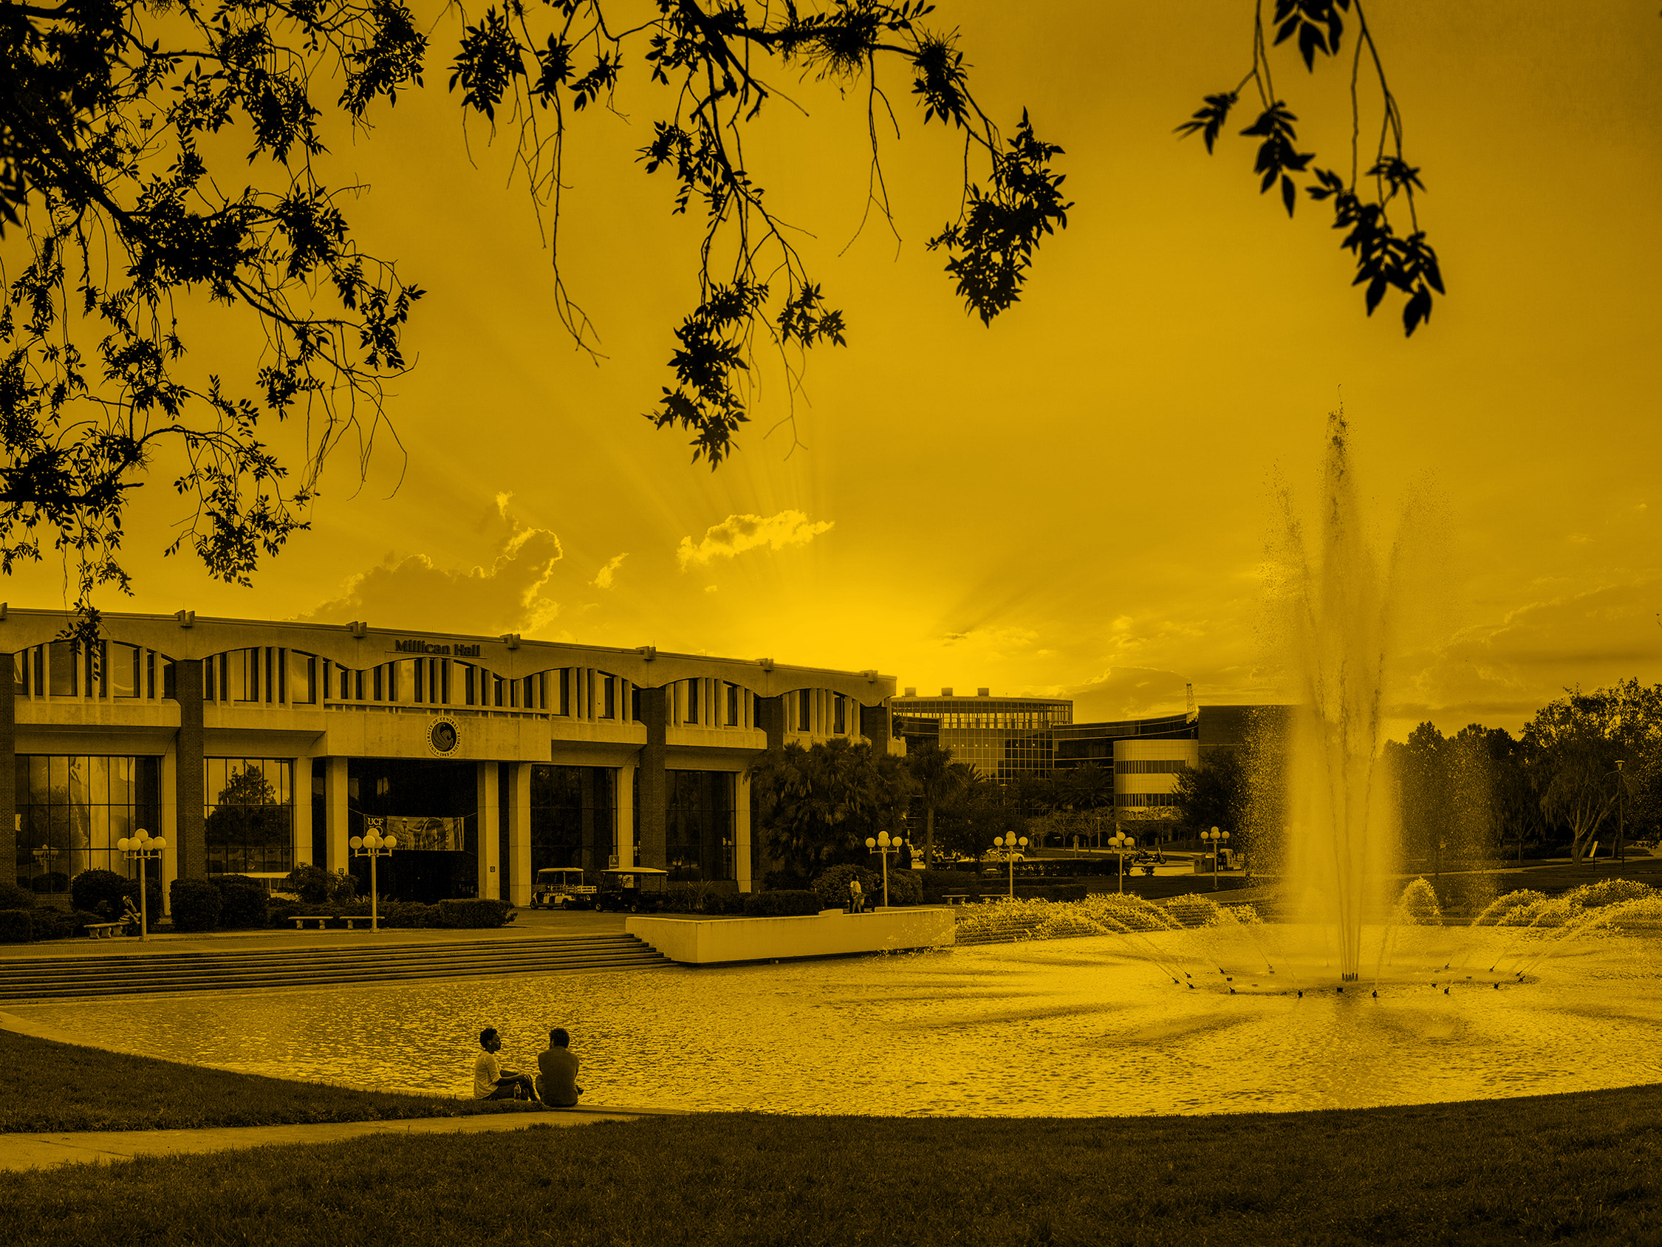
PageUp Update
April 17, 2018

Slide 15
Terri Smith, Asst Dir HRIS
Renee Grigor, Asst Dir Talent Acquisition

Slide 16
PageUp Implementation
Phase 1: Recruitment, Hiring and Onboarding
Status:
System has been configured start to finish for the A&P recruitment process. Working now on USPS, Faculty and OPS.
Defining and building Permissions (what you can do) and Teams (who you can view)
Developing integrations – Truscreen, PeopleSoft and Single Sign On
Working with vendor on Jobs & Onboarding Portals and Emails
Testing, TESTING and TESTING SOME MORE
Developing specifications for reports
Upcoming:
Involve department users in testing
Develop training materials and communication plan
Deliver training
Finalize Security
Go Live
August 2017
Summer 2018
Analysis and Planning
Design and Development
Integrations and Testing
Maintenance and Support
Training and Implementation
Phase 2: Performance Management
Initial Goal:
Move from a paper performance appraisal to an automated one with workflow
Status:
Formed team to work on configuring the system
Go through 5-6 week process with PageUp to build one performance appraisal
Start thinking about where we want to be in the future!
April 2018
December 2018

Slide 17
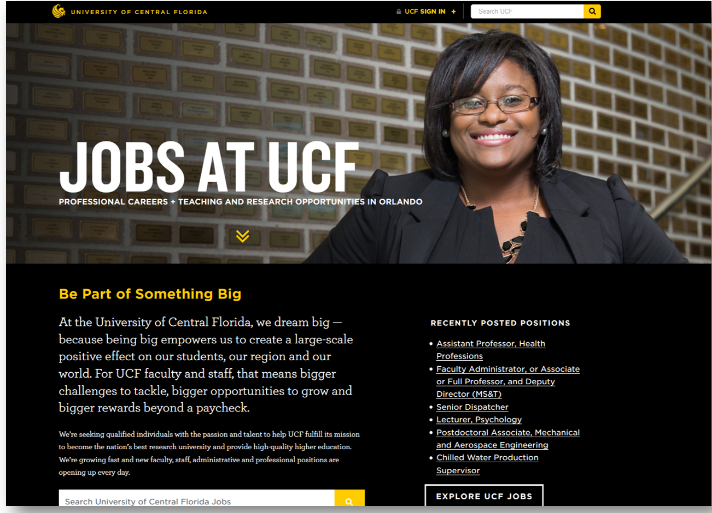
Modern, Appealing, Easy to Use

Slide 18
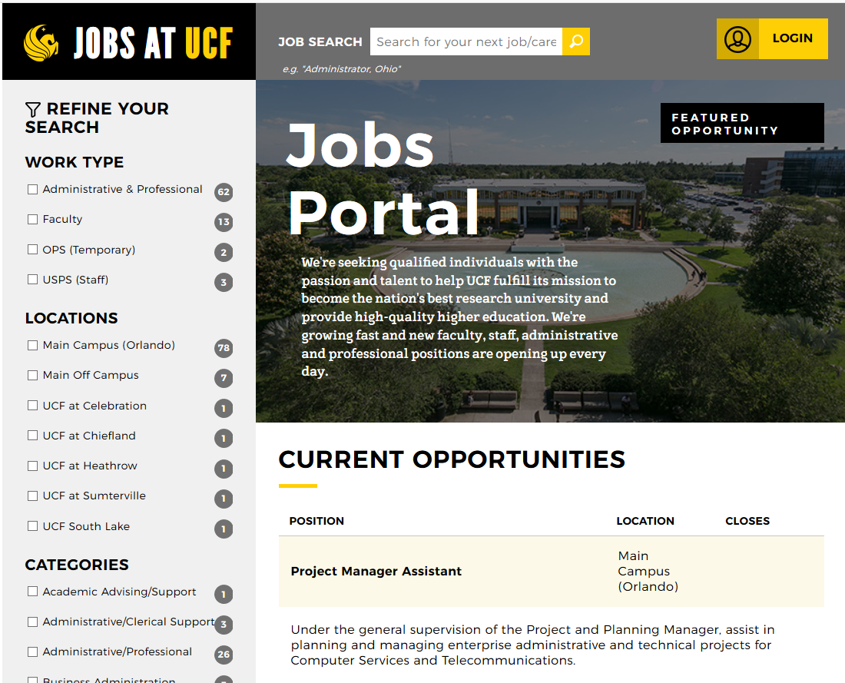
Modern, Appealing, Easy to Use

Slide 19
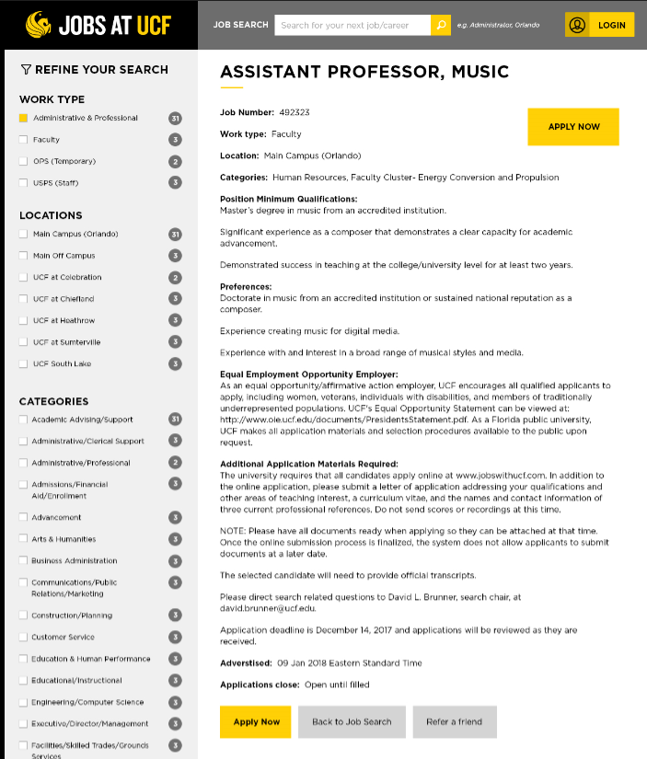
Modern, Appealing, Easy to Use

Slide 20
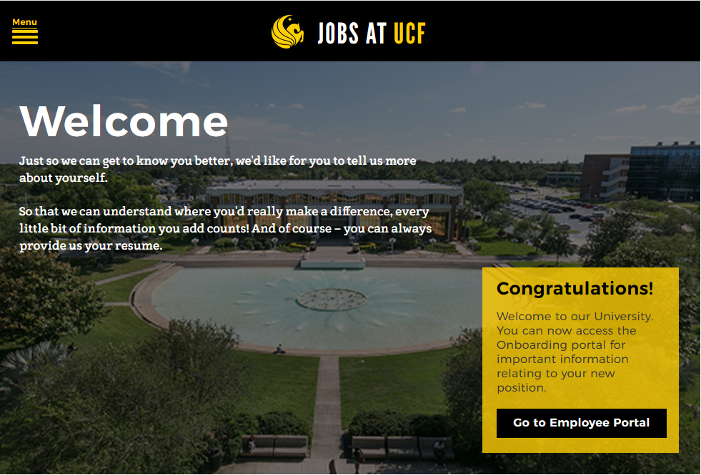
Modern, Appealing, Easy to Use
Notes:
We are really excited about the new hire onboarding features. We are currently completing integrations with our background check vendor, Truescreen, and with the ePAF system.
Benefits:
Create a better employee experience – immerse in UCF culture from the start
More consistency in business processes
Improved efficiency of adding/updating personal and payroll data
Improved data integrity
Better tracking
Eliminate need for paper
Different checklists for different stages of the process (Before start date, first day, first 30 days…)

Slide 21
We Need You
Please continue to give us feedback on the features that will make recruiting easier
Volunteer to help test the system
Send us your current templates for faculty offer letters so that we can provide a consistent, branded experience for all new hires

Slide 22

Questions?

Slide 23

Dependent Eligibility Verification Audit (DEVA)
Notes:
During the 2017 Legislative Session, the Florida Legislature directed the Department of Management Services to contract for dependent eligibility verification services for the State Group Insurance Program. A third-party vendor will administer the dependent eligibility verification services in the form of an audit, which will begin on March 14, 2018.

Slide 24

The State Group Health Insurance Program audit for UCF employees will begin on March 26, 2018 for all State of Florida employees who have dependents enrolled under their health insurance.
Health Management Systems, Inc. (HMS) is the third party company whom the State of Florida has contracted to conduct the audit and verify the eligibility of dependents.
Do Not Send Documents to UCF Human Resources.

Slide 25
What will be required for enrollees under this audit?
Under the audit, enrollees will be required to respond to any requests from HMS for documentation to verify the eligibility of their dependent(s).
If enrollees do not send legible documents to the contracted audit vendor within the timeframe requested, or if their documents do not prove dependent eligibility, the insurance coverage for those particular dependents will be prospectively terminated.

Slide 26
Required Documents: Spouse
If married for less than 12 months and the enrollee and his or her spouse have not filed a joint federal income tax return, a government-issued marriage certificate; or
If married for 12 or more months, a transcript of the most recently filed (2016 or 2017) federal tax return that shows you filed as married, either jointly or separately.

Slide 27

How to obtain tax transcript
You can request a tax transcript online at https://www.irs.gov/individuals/get-transcript; or
Call automated phone transcript service at 800-908-9946 to order a tax return transcript to be sent by mail.
Select the “return transcript” for the most recent year filed (2016 or 2017).

Slide 28
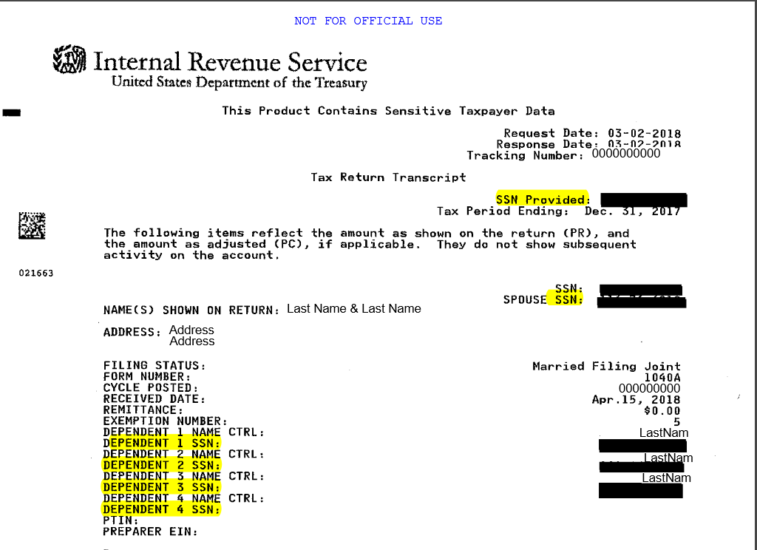
Sample Tax Transcript
Only top portion with your dependents information is needed.

Slide 29
Required Documents: Children
Biological Child
Government-issued birth certificate
Adopted Child
An adoption certificate, or
An adoption placement agreement and a petition for adoption
Stepchild
A government-issued birth certificate for the stepchild, and
The return transcript of the enrollee’s most recently filed federal income tax return to verify the marriage of the enrollee and legal guardian.

Slide 30
Other Dependent Required Documents
Ward
Records showing the enrollee or the enrollee’s spouse has legal guardianship or court-ordered custody of the dependent.
Newborn Grandchild
A government issued birth certificate listing covered dependent as the child’s parent.
Foster Child
Records showing the enrollee or the enrollee’s spouse is the dependent’s foster parent.
Child with Disability
For age 26 or older, proof of eligibility, and
A transcript of the most recently filed (2016 or 2017) federal tax return.
Child age 26-30 (end of calendar year of the 30th birthday)
Proof of eligibility, and
Certification that over-age dependent is unmarried, has no dependents, lives in Florida or attends school in another state and has no other health insurance.

Slide 31
To obtain copies of U.S. birth certificates:
In Florida
Visit the county of birth’s clerk of court’s website (www.floridahealth.gov); or
www.vitalcheck.com.
Out of state
Visit www.vitalcheck.com; or
Call the county of birth’s clerk of court.
All documents must be in English or certified English translation.

Slide 32
How do I submit documentation to HMS?
Instructions on how to submit documentation, reference number, and deadline to respond will be contained in the letter sent by HMS.
There are three ways that documents can be submitted:
  Mail (copies): HMS, P.O. Box 165308 Irving, TX 75016-9923
  Fax: 877-223-8478
  Online Portal: www.verifyOS.com

Slide 33
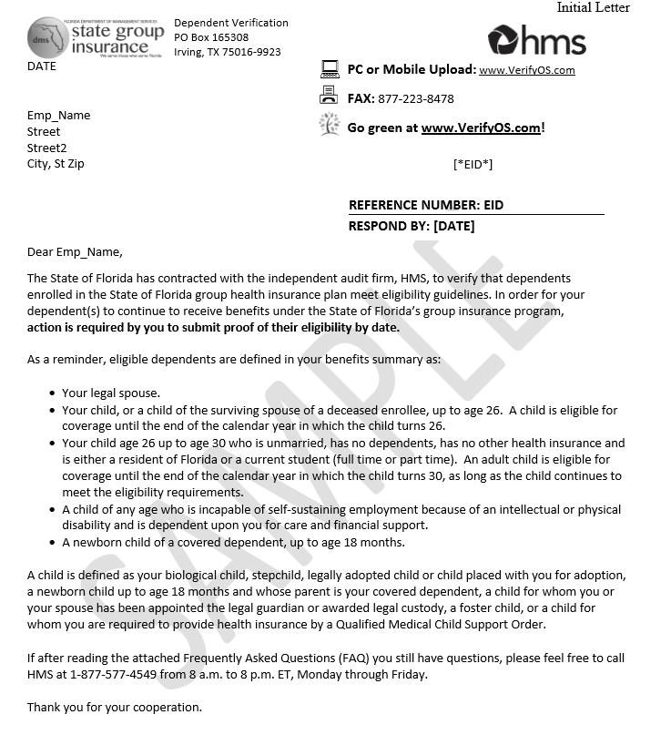
Sample HMS Audit Letter

Slide 34

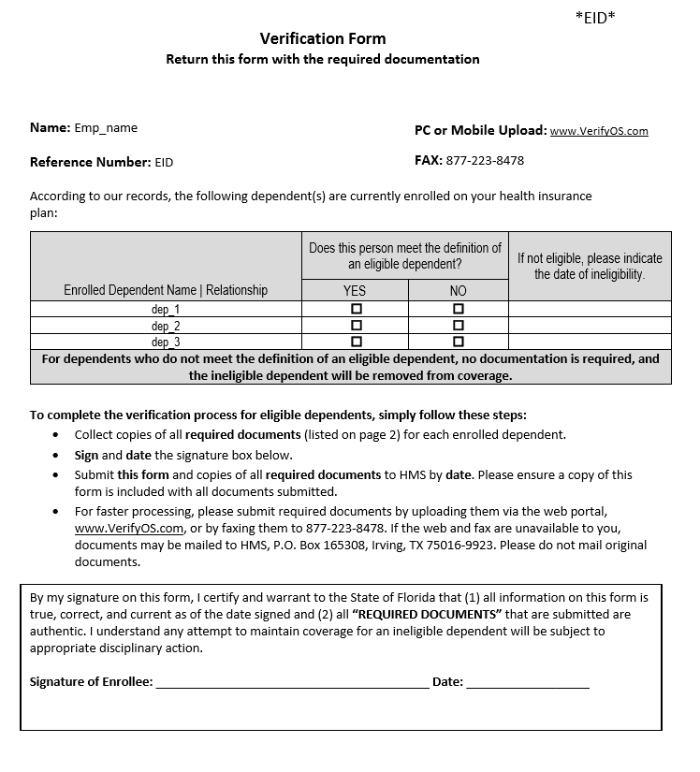
The Verification Form will be included in the packet from HMS and must be signed and submitted along with documents.
*Your Verification Form is available when logging into www.verifyOS.com

Slide 35
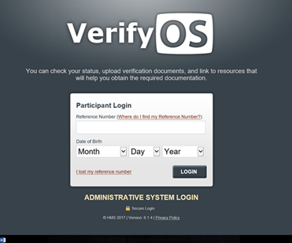
Online Portal: www.verifyOS.com
Participant Login: Reference Number
Only documents saved in .pdf and .jpeg formats will be accepted.
Online Tutorial for Online Submission: https://www.mybenefits.myflorida.com/content/download/140485/906434/VerifyOS_DEVA_participant_guide122817.pdf

Slide 36
Once your documents are received by HMS
You may check the status of each of your dependents by logging on to www.VerifyOS.com.
In addition, you will receive a written communication indicating that you have completed the dependent verification process or if additional information is needed.
Ultimately, it is your responsibility to ensure that your documents were successfully received prior to the deadline.

Slide 37
What happens if I do not submit all required documents by the deadline or fail the audit?
The affected dependent(s) will be removed from coverage.
The State of Florida may seek to recover any premiums or claims paid during the period that the ineligible dependent was covered.
For late document submissions, the next opportunity to add the affected dependents back to coverage will be during Open Enrollment for 2019 coverage.

Slide 38
Summary
Do Not Send Documents to UCF Human Resources.
You must respond to any requests for documentation from HMS to verify the eligibility of your dependent(s).
Instructions on how to submit required documentation along with Verification Form will be contained in the letter sent by HMS.
It is your responsibility to follow up and ensure that your documents were successfully received.

Slide 39
Contact Information & Resources
Health Management Systems, Inc. (HMS)
www.verifyOS.com
(877) 577-4549
Division of State Group Insurance DEVA Page
https://www.mybenefits.myflorida.com/health/dependent_eligibility_verification
UCF Human Resources Benefits Section
(407) 823-2771
Benefits@ucf.edu

Slide 40
Q & A

Slide 41
Closing Remarks

Slide 42
Shelia Daniels
Executive Director Human Resources

