Slide 1

Your Retirement Plan at Work
Photo collage
Helping you prepare for a more fit retirement journey
Jacquie Bletzacker
Senior Financial Advisor
Notes:
With essential living expenses like housing, food, fuel and insurance premiums rising, some of you may be tempted to put off saving for your retirement. It may not seem important to save for retirement when you need money now; especially if your retirement seems far away. On the other hand, some of you would like to save for retirement, but you feel that your budget is already overextended. Still, others of you may be wondering what will happen to your money if you leave your current employer. Or, maybe you’re not sure you’ll have access to your money when you need it. It’s natural to have these concerns; especially in today’s economy.

Slide 2
Agenda
1 | What generation are you?
2 | Saving for retirement
3 | Your workplace retirement plan
4 | Enrolling in your workplace retirement plan
5 | Putting it all together
Notes:
Here are today’s topics [read agenda.]
After today’s session, you’ll be able to:
Identify the reasons why it’s important to start saving for retirement.
Describe the benefits of participating in your workplace retirement plan.
Evaluate the features of the most common retirement plans offered by employers.
Take action toward saving for a comfortable lifestyle in retirement.

Slide 3
What generation are you?
Notes:
Each generation views the world differently. It’s evident in the clothes we wear, the cars we drive and the music we listen to. But, it may surprise you that the same holds true when it comes to saving for retirement. Think about your parents’ and grandparents’ generations. How did they plan for retirement? What did they do differently? What helped shape their views about retirement?

Slide 4
What generation are you?
“…the year you were born partly determines what generation you belong to, but so do your cultural experiences. Your teenage years are the years when people are most influenced by the world around them…”
Source: Senior Moment. USAToday.com.
Retrieved February 6, 2014.
Notes:
According to USA Today, “…the year you were born partly determines what generation you belong to, but so do your cultural experiences. Your teenage years are the years when people are most influenced by the world around them…”¹
Do you know what generation you belong to? Before we dive into the presentation, I’d like to take you back in time with a fun set of questions. These questions are based on the USA Today’s online generations quiz. Record your answers on page 2 in your workbook. At the end of the quiz, you’ll see what generation you’re in.
[Note to speaker: The five generations are: G.I. Generation (-1936), Silent Generation (1937-1945), Boomers (born 1946-1964), Generation X (1965-1976) and Millennials (1977-1993).² In this presentation we will focus primarily on Boomers, Generation X and Millennials.]
Sources:
¹Senior Moment. USA Today. http://projects.usatoday.com/news/generations/results/#id=164008,share=true. Retrieved September 2016. ²Generations and their gadgets. Pew Research Internet Project. February 3, 2011.

Slide 5



What generation are you?
Generation quiz
  What technology came into being when you were a teenager?
A
B
C
MP3 player
Walkman
First cell phone
Notes:
[This slide has animations; items automatically appear. Read question and items. Allow time for participants to select an answer in their workbook.]
MP3 player
Walkman
First cell phone
5

Slide 6



What generation are you?
Generation quiz
  What was the blockbuster movie when you were a teenager?
A
B
C
Star Wars
Back to the Future
Titanic
Notes:
[This slide has animations; items automatically appear. Read question and movie titles. Allow time for participants to select an answer in their workbook.]
Star Wars
Back to the Future
Titanic
6

Slide 7



What generation are you?
Generation quiz
  What song was popular when you were growing up?
A
B
C
YMCA
(Village People)
I Love Rock-n-Roll
(Joan Jett and the Blackhearts)
Oops!...I Did It Again
(Britney Spears)
Notes:
[This slide has animations; items automatically appear. Read question and song titles. Allow time for participants to select an answer in their workbook.]
YMCA (Village People)
I Love Rock-n-Roll (Joan Jett and the Blackhearts)
Oops!...I Did It Again (Britney Spears)
7

Slide 8




What generation are you?
Generation quiz
  Where do you currently get your news and information?
A
B
C
D
Newspaper
Television
Radio
Online
Notes:
[This slide has animations; items automatically appear. Read question. Allow time for participants to select an answer in their workbook.]
Newspaper
Television
Radio
Online (Internet)
8

Slide 9







What generation are you?
Your generation
Category
Boomers
(Older/Younger)
(1946 – 1964)
Gen X
(1965 – 1981)
Millennials
(1982 – 1997)
 | Walkman (1979) | First Cell Phone (1986) | MP3 Player (2001)
 | Star Wars (1977) | Back to the Future (1983) | Titanic (1997)
 | YMCA (1979) | I Love Rock-n-Roll (1982) | Oops!... I Did It Again (2000)
 | Television & Newspaper | Television, Radio & Online | Online
Sources:
What Generation Do You Belong To? Quiz. USA Today.com. Retrieved September 2015.
Generational Differences: Millennials, Social Media and Education. August 19, 2013.
Notes:
[Note: This is the answer key. The dates under each generation signify when the generation was born. The offset years are when they were teenagers growing up. For example: Boomers were born in 1946 – 1964 but grew up in the 60s and 70s.]
So what generation are you? This chart shows an offset of birth years to teenage years. It’s interesting to see how each generation looks at the world based on the cultural experiences they grew up with.
9

Slide 10
What generation are you?
What’s your generation’s outlook on retirement?
I’m not confident on being financially prepared for retirement.
I may retire late, or not at all.
Boomer
I expect to self-fund my retirement with employer-sponsored
retirement plans.
Gen X
I’m very confident about being financially stable in retirement.
I’m already saving for retirement.
Millennials
Source: 3 Generations Face USA’s Retirement Crisis. USA Today. May 10, 2014.
Notes:
The same is true about retirement. How will cultural experiences help shape your views about retirement?
Baby Boomers grew up in affluent times (fat fifties and turbulent sixties).¹ Yet, Boomers may be at risk of running out of money in retirement. Why? Because they were already well into their working careers when the retirement landscape changed from defined benefit plans to 401(k) or similar plans, and may not have saved or invested enough to experience the full effects of long-term compounding interest. In a survey, only 37% say they are very confident about being prepared financially for retirement, with the same percentage (14%) reporting retirement after age 65.²
Generation X entered the workforce in the 1980s and is the first generation to have access to 401(k) plans for most of their working careers. They started saving for retirement at a median age of 27. More than half expect to self-fund their retirement with 401(k) or similar plans. Total household retirement savings for Generation X is about $70,000, however, they estimate that they will need to save $1 million (median) to retire with a comfortable lifestyle, a huge gap compared to what they have saved to date. Although the clock is ticking for Gen Xers, they still have time to substantially improve their retirement prospects.
Many Millennials began entering the workforce during the Great Recession of 2007 - 2009, which made it much harder to find work. Yet, they are the most confident about their futures. In fact, 17% say they have fully recovered from the recession, and 21% say they were not impacted at all. One in five are very confident that they will be able to live a comfortable lifestyle in retirement. Meanwhile, 60% expect to retire before age 65.³ Millennials are particularly conscious of the need to plan ahead to weather economic downturns and take their retirement benefits very seriously. In a survey, 70% of Millennials are already saving for retirement, starting at an unprecedented age of 22 (median).⁴
Sources:
¹Senior Boom Begins Amid Economic Bust. USA Today. November 2010.
²EBRI, The 2015 Retirement Confidence Survey: Having a Retirement Savings Plan a Key Factor in Americans’ Retirement Confidence. Issue Brief No. 413, April 2015.
³3 Generations Face USA’s Retirement Crisis. USA Today. May 10, 2014.
⁴Millennial Workers: An Emerging Generation of Super Savers. Transamerica Center for Retirement Studies, 15th Annual Transamerica Retirement Survey, July 2014.
10

Slide 11

What generation are you?
Have you considered?
  You could live longer than you think
100
Or beyond!
Notes:
And have you considered that you may live to be 100 years old, or beyond! It’s true. Good nutrition and medical science are extending life exponentially. During that time, you could reinvent yourself to pursue two or three careers or even start a business. You may even take time off in your fifties to go back to school.

Slide 12
Saving for retirement
Notes:
So, why save for retirement? And why start now?

Slide 13
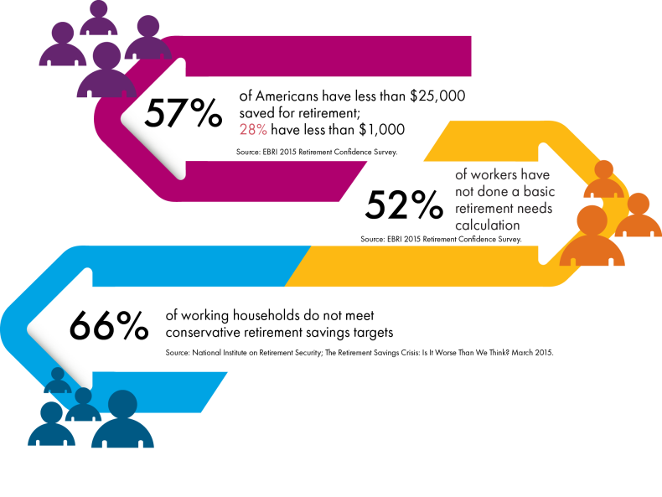
Saving for retirement
Preparing for retirement
54%
of Americans have less than $25,000 saved for retirement; 26% have less than $1,000
Source: EBRI 2016 Retirement Confidence Survey.
52%
of workers have
not done a basic retirement needs calculation
Source: EBRI 2016 Retirement Confidence Survey.
66%
of working households do not meet conservative retirement savings targets
Source: National Institute on Retirement Security; The Retirement Savings Crisis: Is it Worse Than We Think? March 2015.
Notes:
Current research on retirement preparedness for the average American isn’t all positive. According to the Employee Benefit Research Institute, in a 2016 study, 54% of Americans have less than $25,000 saved for retirement. Even more troubling, 26% have less than $1,000.
An important part of preparing for retirement is to actually have a plan for how to get there. Unfortunately, research shows that 52% of workers have not even done a BASIC retirement needs calculation.
The National Institute on Retirement Security informs us that 66% of working households are not meeting even conservative retirement savings targets.
You might consider working with a financial advisor to develop a financial plan to see if you are on track to meet your retirement savings goals.

Slide 14




Saving for retirement
Possible challenges
Higher
personal
debt
Greater responsibility
to save
Longer life expectancy
Concern for the future of
Social Security
Notes:
[There are animations on this slide. Click for text to appear.]
Regardless of generational differences, we all face the same set of challenges when preparing for retirement in today’s economy:
Personal debt levels are extremely high. Did you know that the total outstanding revolving debt in the United States is $1,022 BILLION?¹ With a national average of 15% interest rate (23% or more if bad credit)², balances are hard to pay off. Debt may also include caring for elderly parents while also paying for a child’s college tuition; such is the case for many of the “Sandwich Generation.” (Sandwich generation – Baby Boomers caught in the middle of aging parents and raising children but still trying to save for retirement.)
And, as the shift from defined benefit plans toward defined contribution plans continues, people have a greater responsibility to plan and save for retirement. Yet, 24% of Americans say they have saved less than $1,000 and 47% have saved less than $25,000; excluding primary residence and defined benefit plans, if any.³ Preparations for retirement are lacking as many people spend a great deal of money on educating their children and may even continue to provide financial assistance to their adult children.
Also, the future of Social Security is uncertain. Understandably, this causes concern for those who plan to rely on Social Security as their only source of guaranteed lifetime income.
People are living longer in retirement. Living longer means retirement income has to last longer. People should plan on funding a 20- to 30-year retirement. At a retirement age of 65, a man could expect to live on average until age 84, and a woman until age 86. They also have about a 25% chance of living to age 90 and 10% chance of living past age 95.⁴ Today, centenarians (people age 100 and older) are a growing segment of the population. In the U.S. alone there are over 55,000 centenarians.⁵
Sources:
¹Average Credit Card Debt in America: 2017 Facts & Figures. ValuePenguin.com.
²Average Credit Card Interest Rates Rise to 15.07 Percent. CreditCards.com. October 1, 2014.
³The 2017 EBRI Retirement Confidence Survey: Many Workers Lack Retirement Confidence and Feel Stressed About Retirement Preparations. March 21 2017, No. 431.
⁴Calculators: Life Expectancy. Socialsecurity.gov.
⁵The Centenarian Population: 2007 – 2011, April 2014. U.S. Census Bureau.

Slide 15

Saving for retirement
How will you pay for all those extra years in your future?
Estimated percentage of last working year’s salary you’ll need to maintain your lifestyle in retirement
80%
Source: Retirement Benefits. SSA Publication No. 05-10035. Social Security Administration. January 2015.
Notes:
With all those extra years in your future, how are you going to pay for them? As a guide, for every year in retirement you’ll need approximately 80% of your last working year’s salary to maintain your lifestyle in retirement. Living longer means your money will need to last longer.
15

Slide 16

Saving for retirement
Even modest inflation over time can have a major impact
on your investments
2015
$1.42 per loaf
2000
92¢ per loaf
1990
70¢ per loaf
1980
50¢ per loaf
Source: Average Price Data. Consumer Price Index, Bureau of Labor Statistics. January 2016.
Notes:
Your investment should ideally grow faster than inflation. If not, you are actually losing in terms of buying power. Inflation is a persistent increase in the cost of goods and services. Even modest inflation over time can have a major impact on your investments.
Take a look at how the price of bread has increased over the years. Imagine what prices will be like in ten, twenty or even thirty years from now. If you live on a fixed income, it may take more money to buy the things you need. That’s why it’s important to address inflation in your overall investment strategy.

Slide 17
Saving for retirement
Sources of retirement income
Earnings
Social Security
Pension plan
Asset income/other
Please note that this is just one scenario and the sources of retirement income will vary depending on your individual situation.
Source: Income of the Aged Population, Shares of Aggregate Income by Source, 1962 and 2015. Fast Facts and Figures About Social Security, 2017. SSA Publication No. 13-11785. Released September 2017.
Notes:
The realities of today’s retirement can be daunting. So, where will your retirement income come from? Retirement income traditionally depended on three sources: Social Security, retirement plan or pension plan and savings. With fewer employers still offering pension plans to new employees and Social Security only intended to supplement part of your retirement income, you have a bigger responsibility to self-fund your retirement with other income sources, such as with savings or even the growing option of working in retirement. Will you need to continue working?
Keep in mind that the percentages will vary depending on your individual situation. When planning for retirement, you will need a financial plan to account for income from other sources to supplement your Social Security benefits. Let’s discuss each of these sources.

Slide 18
Saving for retirement
Historical average annual Social Security benefits
Sources: (Years 1940 – 2010). Average Monthly Social Security Benefits (calculated to provide annual total),
1940–2011.Social Security Bulletin: Annual Statistical Supplement. SocialSecurity.gov.
(Year 2016). 2014 Social Security Changes, Fact Sheet and 2016 Social Security Changes, Fact Sheet. ssa.gov.
Notes:
18
Social Security is one of the largest sources of income for many retirees. This chart shows annual Social Security benefits since 1940. Although benefits have increased over the years, the amount may not be enough for most people to maintain a comfortable lifestyle in retirement in today’s economy. And, keep in mind that if you retire before full retirement age, say before age 66, your benefits are reduced. If however, you wait until full retirement age to start drawing Social Security benefits, you may have to start drawing down your retirement savings. Either way, there will likely be a gap to fill; whether it’s at the start of retirement or when savings run out. And because, on average, women receive significantly smaller payments from Social Security and pensions than men do, they need to focus on self-funding a greater portion of their retirement. This is even more greatly impacted by the fact that, on average, women live longer and are considered the main caregivers to their children and adult parents.
Consequently, there is a need to implement an income-generating strategy that can help cover your essential living expenses in retirement.
A good financial plan can assist you in determining how to utilize and maximize other sources of retirement income.

Slide 19
Saving for retirement
Reasons people delay saving for retirement
 | 20s | 30s | 40s | 50s
Roadblock | “I’m too young” | “Too many expenses” | “Saving for child’s college tuition” | “Supporting children and parents”
Opportunity | Time is on your side | Pay yourself first | Compound savings | Workplace plan and catch-up provision
Notes:
19
[OPTIONAL SLIDE.]
Over the years, I’ve heard many reasons why people delay saving for retirement. Basically, life happens and saving for retirement is put on the back burner. Let’s look at some common roadblocks to saving.
In your 20s…“I’m too young to worry about saving for retirement.”
When in your twenties, retirement seems so far off. You’ve just finished college, started a career and, for now, all your income goes to everyday expenses. But, this is the best time to start saving; time is on your side. With forty-plus years ahead you’ll have the power of compounded growth working for you. You’ll also have time to recover from any market downturns and experience gains when the market rises.
In your 30s…“I have too many expenses to save right now.”
When in your thirties, you start thinking about saving for retirement. At this life stage, time is still on your side. As your career advances and income increases, it should be easier to put aside small amounts each month for your retirement. Consider paying yourself first as part of your budget. But, since you’re paying a mortgage, have child care and other expenses you may be procrastinating.
In your 40s…“I can’t save now, I’m saving for my child’s college tuition.”
When in your forties, you may feel torn between saving for retirement and saving for your child’s college tuition. One thing to keep in mind is money for college can be borrowed, but can’t be borrowed to fund your retirement. It is usually at this life stage when most people start to worry about saving for retirement. But be encouraged because you still have twenty-plus years for your savings to compound to a significant amount for retirement.
In your 50s…“I’m supporting my children and my parents. It’s too late anyway, right?”
When in your fifties, you may be supporting grown children and aging parents. And, you may be thinking it’s too late to start saving. In fact, this is a critical time to save. You still have time to take advantage of your workplace plan and certain catch-up provisions. These provisions allow those fifty and older to contribute over the regular limits. Also, your financial advisor can help you implement strategies to help generate income and protect your retirement income from market downturns.

Slide 20

Saving for retirement
How much should you save for retirement?
$
Estimated percentage of income needed to save annually to meet your retirement goals
This percentage is only a guideline. The percentage may increase depending on your investment goals and time horizon.
Source: How Much Should You Save for Retirement? Bloomberg.com. June 14, 2017.
Notes:
So now that you know how important it is to save for retirement, how much should you be saving? According to the Boston College Center for Retirement, it depends on when you plan to retire, but suggests that you should consider starting to contribute 15% of your salary to a retirement plan in your 20s if you plan to retire at age 62, and think about increasing that percentage if you start later. The target savings amounts can be very high if you start saving, say at age 45.
20

Slide 21
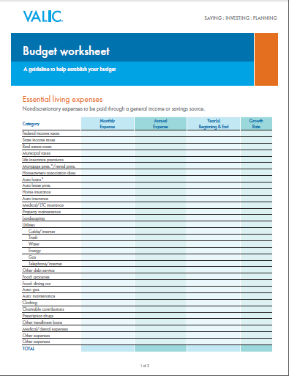
Saving for retirement
Create a budget
 | Jan | Feb | Mar
INCOME
Salary
$ 2,800
$ 2,800
$ 2,800
Investment gains
$ 0
$ 0
$ 0
Bonus
$ 175
$ 225
$ 95
Tips
$ 350
$ 500
$ 275
TOTAL
$ 3,325
$ 3,525
$ 3,170
EXPENSES
Rent/mortgage
$ 1,200
$ 1,200
$ 1,200
Car payment
$ 375
$ 375
$ 375
Fixed
Insurance
$ 150
$ 150
$ 150
Student loan
$ 200
$ 200
$ 200
Credit card
$ 125
$ 125
$ 125
Savings
$ 50
$ 50
$ 50
Groceries
$ 150
$ 225
$ 175
Variable
Utilities
$ 325
$ 250
$ 275
Entertainment
$ 100
$ 275
$ 150
Personal/misc.
$ 150
$ 210
$ 175
TOTAL
$ 2,825
$ 3,060
$ 2,875
BALANCE
(INCOME – EXPENSES)
$ 500
$ 465
$ 295
Notes:
If you’re not sure how much you can save, consider creating a household budget. A budget is an itemized allocation of available funds and forms the foundation on which you will begin to build your own personal financial plan. It’s a great way to assess your essential and discretionary expenses. With a household budget, you’ll see areas where you can reduce non-essential spending so you can grow your savings. Your salary includes any money you can safely expect on a consistent basis such as salary or investment income, say from a rental property. Keep in mind that if you receive monthly tips or bonuses, unless they are fixed amounts, you may want to be conservative in your estimate.
Your expenses could be fixed or variable. And since your monthly available balance might fluctuate, you want to be realistic about how much you allocate toward savings. You may start small, but make sure it becomes a recurring fixed expense going forward.
Please note that this is just an example of basic income and expense items. Your actual income and expenses will vary depending on your individual situation. If you need assistance developing a budget and a financial plan, I can help you get started.
[Presenter: Consider handing out VC 17434 Personal Budget Worksheet to attendees as a takeaway]

Slide 22
Your workplace retirement plan
Notes:
It’s a matter of balancing other goals while at the same time saving for retirement. Participating in your workplace plan can help you accumulate the money you need to enjoy the retirement lifestyle you envision.

Slide 23
Your workplace retirement plan
Time is money, start saving early
25-year-old
$300 monthly for 10 years
More than $200,000
by age 65
5%
annual rate
of return
This hypothetical example illustrates the cost to accumulate more than $200,000 by age 65 with the assumptions indicated. Tax-qualified plan accumulations are taxed as ordinary income when withdrawn. Federal restrictions and tax penalties may apply to early withdrawals. This information is hypothetical and
only an example. It does not reflect the return of any investment and is not a guarantee of future income.
Notes:
Every day you delay saving for retirement means less time to benefit from compound interest and you miss out on extra time to recover from any possible financial market downdrafts. And the only solution you have to make up for that time is to save more in the time remaining until retirement and/or work longer.
Let’s consider a hypothetical example. A 25-year-old who started investing $300 a month for ten years could have accumulated $200,000 by age 65, assuming a 5% annual rate of return.
If you do, not only will it cost less to accumulate a substantial nest egg, but you’ll have plenty of years to recover from any financial market downdrafts.
23

Slide 24
Your workplace retirement plan
How much should $200,000 cost?
The cost of procrastination
$300 per month for 10 years
$300 per month for 21 years
$300 per month for 27 years
This hypothetical example compares the total out-of-pocket costs required to fund the retirement goals of an investor if the investor started contributing $300 a month at different ages. This example assumes a 5% annual rate of return. Tax-qualified plan accumulations are taxed as ordinary income when withdrawn. Federal restrictions and tax penalties can apply to early withdrawals. This information is hypothetical and only an example. It does not reflect the return of any investment and is not a guarantee of future income. Investing involves risk, including possible loss of principal. NOTE: $300 in pretax contributions would equal about $400 out of pocket if paid with after-tax dollars.
Notes:
But look how the cost increases the longer the investor waits. A 35-year-old saving $300 monthly for 21 years, an outlay of $75,600, could reach his/her goal by age 65. However, a 45-year-old would have to save $300 monthly for 27 years investing $97,200 out of pocket to achieve the same goal. Which means, this person wouldn’t reach his/her goal until age 72. As you can see, starting early can make a difference.
If you do have a long time horizon, investment options with more short-term volatility and potential for higher returns may be worth considering.
However, the clock starts to work against you as you approach retirement. Recovering from losses can be more difficult. Yet, overreacting to inevitable market ups and downs can also deprive your savings of continued growth potential. Less volatile investments and the potential for more moderate returns may be a better fit if you have a short time horizon.
And, depending on the lifestyle you want in retirement you might also consider working with a financial advisor to help you develop an overall retirement savings strategy.
So, when do you want to retire? What is your goal?
24

Slide 25


Your workplace retirement plan
  Benefits of participating in your employer-sponsored
  retirement plan
+
Automated savings
Tax advantages
Matching contributions
Automatic payroll deduction
Tax-deferred growth
Helps increase your savings
Notes:
Now that you know the importance of saving early for retirement, why not start saving for your future with an employer sponsored retirement plan? The benefits offered include:
Automated savings. Taking contributions directly out of your paycheck helps ensure that you are paying yourself first.
Tax advantages. Retirement plans let you defer income taxes until withdrawal. (Income tax is payable upon withdrawal and withdrawals before age 59 ½ may incur a 10% federal early withdrawal tax penalty.)
Matching contributions. Many employers match a percent of contributions. If your employer doesn’t, perhaps your spouse’s plan does.

Slide 26
Your workplace retirement plan
Common workplace retirement plans
  Tax-deferred¹
  Taxable²
403(b) | Public schools and nonprofit
Roth 403(b) | Public schools and nonprofit
457(b) | Government and tax-exempt
Roth 457(b) | Government and tax-exempt
401(k) | Non-government employers
Roth 401(k) | Non-government employers
¹Income taxes are payable upon withdrawal; federal restrictions and a 10% federal early withdrawal tax penalty might apply to withdrawals prior to age 59½.
²Roth contributions are after-tax contributions.
Notes:
The most common tax-qualified plans offered by a workplace retirement plan are the 403(b), 457(b), and 401(k) plans, which were named for the Internal Revenue Service codes that established them. Even if you only expect to participate in one of these types of plans, it’s best to have some understanding of all three in case you have a spouse who participates in one of the others or you have that opportunity, yourself, sometime in the future.
The 403(b) plan was designed specifically for public schools and nonprofit organizations like hospitals and churches.
The 457(b) plan takes two paths— one designed for government organizations and the other for tax-exempt organizations.
The 401(k) plan is available to all non-governmental employers.
All three plans can offer a broad range of investment options including annuity contracts and mutual funds.
Pretax contributions by payroll deduction into a traditional 401(k), 403(b) or 457(b) can help reduce the amount of your current taxable income so you can save dollars for retirement that otherwise would have gone to pay taxes. So while you are working, whether you’re five or thirty-five years from retirement, your money grows tax-deferred until withdrawn. (Keep in mind that upon distribution, both contributions and earnings are taxable.)
Your employer may also choose to offer a Roth element in a 401(k), 403(b) or governmental 457(b) plan. Roth account contributions are made on an after-tax basis. However, if withdrawals from Roth accounts meet the criteria for qualified withdrawals, they are tax-free. Generally, a qualified Roth distribution is a distribution that (1) is withdrawn after the end of the five-year period beginning with the first year in which a Roth contribution was made to the plan, and (2) is after reaching age 59½, death or disability.
26

Slide 27
Your workplace retirement plan
Contribution limits
2018
 | Traditional and Roth
 | 403(b) | 457(b) | 401(k)
Annual limit | $18,500 | $18,500 | $18,500
Contribution method | Deferral via salary-reduction agreement
Age-based catch-up (50+) | $6,000 | $6,000* | $6,000
*Not applicable to 457(b) tax-exempt organizations.
Notes:
These plans are very similar; especially, when it comes to contribution limits for 2018.
All three plans allow elective deferrals via salary-reduction agreement.
All three plans limit employee contributions to $18,500.
Combined limit for 403(b) and 401(k) plans.
Separate limit for 457(b) plan.
Additionally, participants age 50 or older are allowed to “catch up” if they choose to make up for under-contributing to their workplace retirement plans.
For 2018, the age-based catch-up feature allows participants who are age 50 or older to contribute an additional $6,000 to their retirement accounts. This feature does not apply for 457(b) tax-exempt organizations.

Slide 28
Your workplace retirement plan
Service-based catch-up contributions
2018
 | Traditional and Roth
 | 403(b) | 457(b) | 401(k)
Limits | Up to $15,000 ($3,000 per year) | Up to $18,500 per year | N/A
Eligibility | Participants with 15 years of service who contributed on average less than $5,000 per year for the prior 15 years in qualifying plans | Additional contribution is in the three years prior to the year participant reaches plan’s normal retirement age, but only if undercontributed in prior years
Notes:
Service-based catch-up contribution deferrals are allowed for 403(b) and 457(b) plan participants.
With qualifying 403(b) plans, if you have 15 years of service you may contribute an additional $3,000 per year up to a total of $15,000 if you contributed on average less than $5,000 per year for the prior 15 years. This is called the “15-year rule.”
With the 457(b) plan, you can contribute up to an additional $18,500 per year in the three years before the year you reach the plan’s normal retirement age if you under-contributed in prior years. However, you can’t make both types of catch-up contributions (age-based and special) in the same tax year.
This feature does not apply to 401(k) plans.
You may want to check with your plan administrator to verify your eligibility under these catch-up provisions.
28

Slide 29
Your workplace retirement plan
Maximize your tax-deferred savings
2018
 | 403(b) | 457(b) | Combination plans
Annual contribution limit | $18,500 | $18,500 | $37,000
Special catch-up contribution | $3,000 (15-year rule) | Up to $18,500* (3 years prior to retirement age) - or - $6,000* | $21,500
Age-based catch-up | $6,000 |  | $6,000 (Assuming 403(b) age-based catch-up is selected)
Maximum deferral | $27,500 | $37,000 | $64,500
Salary deferral amounts are up to you!
*You can only select either the special catch-up contribution or age-based catch-up contribution for 457(b) plans.
Notes:
Eligible participants contributing the maximum to their retirement plans could possibly save:
Up to $27,500 for 403(b) participants—includes $18,500 plus $3,000 for 15-year rule plus $6,000 age-based catch-up
Up to $37,000 for 457(b) participants—includes $18,500 plus an additional $18,500 special catch-up contribution or $6,000 age-based catch-up contribution (only one catch-up can be made in the same year)
Up to $64,500 if participating in a combination plan [403(b) and 457(b)]—includes annual deferrals and the maximum catch-up contributions
Keep in mind that salary deferral amounts are up to you. You may increase or decrease the amount you contribute to the plan as often as your employer allows. You may also discontinue contributions and resume them subject to the employer plan provisions. The account will continue to grow on a tax-deferred basis.
29

Slide 30
Your workplace retirement plan
When do withdrawals begin?
403(b)
401(k)
Reach age 59½ or 70½
Severance from employment
Death or disability
Financial hardship
Withdrawals prior to age 59½ might be subject to federal restrictions and a 10% federal early withdrawal tax penalty. Income taxes are due upon withdrawal.
457(b)
Reach age 70½
Severance from employment
Death
Unforeseen emergency
No early withdrawal penalty. Income taxes are due upon withdrawal.
Notes:
There are a few conditions to taking money from your retirement account. For 403(b) and 401(k) plans, your account contributions may be distributed:
Upon reaching age 59½, with required distribution at age 70½
At severance from employment, either due to termination or retirement
At your death, at which time the beneficiary is eligible for distributions
At disability, or
If you experience a financial hardship
For 457(b) plans, account contributions may be distributed:
Upon reaching age 70½
At severance from employment, either due to termination or retirement
At your death, at which time the beneficiary is eligible for distributions, or
Due to unforeseeable emergencies

Slide 31
Your workplace retirement plan
Withdrawals from your retirement plan at work
Lump-sum withdrawals
20% immediate withholding Ordinary income taxes 10% federal early withdrawal tax penalty, if under age 59½*
Systematic withdrawals
Payments at regular intervals Ordinary income taxes 10% federal early withdrawal tax penalty, if under age 59½*
Annuitization
Periodic payments, irrevocable Ordinary income taxes 10% federal early withdrawal tax penalty, if under age 59½*
Rollover
Direct: No income taxes, penalties or 20% employer tax withholding
Indirect: 20% withholding Must roll over cash, plus 20%, within 60 days If over 60 days, income taxes and 10% federal early withdrawal tax penalty apply (if under age 59½*)
*The 10% federal early withdrawal tax penalty does not apply to 457(b) plans.
Notes:
Key to making your money last in retirement is to understand when to start taking withdrawals and how to minimize the taxes you’ll pay on those distributions. The most common ways to withdraw funds from a tax-qualified retirement plan are:
Lump-sum withdrawal. You may take your full balance as an immediate cash distribution; however, your employer is required to withhold 20% for tax purposes. And, you may be subject to additional income taxes plus a 10% federal early withdrawal tax penalty if you are under age 59½ when you take the distribution, unless certain conditions are met.
Systematic withdrawals. You may take payments from a retirement plan in regular intervals (monthly, quarterly, annually) to comply with minimum distribution requirements or severance from employment. Ordinary income taxes are due on the amount withdrawn and a 10% federal early withdrawal tax penalty may apply if you are under age 59½ when you start taking distributions, unless certain conditions are met.
Annuitization. You may convert all or a portion of your annuity investment into a series of periodic income payments to be paid at an interval of your choosing; this is annuitization. Annuitization is generally an irrevocable decision so consider this option carefully. Ordinary income taxes are due on the amount withdrawn and a 10% federal early withdrawal tax penalty may apply if you are under age 59½ when you start taking distributions, unless certain conditions are met.
Rollover. Another way you can take a distribution is to roll your retirement savings into another tax-qualified retirement program, either an Individual Retirement Account (IRA) or a Roth IRA. This can be done directly or indirectly. With a direct rollover option, funds are transferred directly from your qualified plan to an IRA or another qualified plan. You do not pay income taxes or penalties and you also avoid the 20% tax withholding by your employer. However, with an indirect rollover option, you take possession of the cash and your employer must withhold the 20%. You have 60 days to roll over the cash tax free into another qualified plan or an IRA, including replacing the 20% to avoid it being taxed. If you wait longer than 60 days, you’ll pay income taxes on the entire distribution and a 10% federal early withdrawal tax penalty may apply if you are under age 59½.
Please note that rollovers are not allowed on non-governmental 457(b) plans. And, the 10% federal early withdrawal tax penalty does not apply to 457(b) plans.
31

Slide 32

Your workplace retirement plan
Tax-free loan provision
  Loans subject to employer plan provisions
  If defaulted, unpaid loan balance will be taxed as ordinary income and might incur a 10% federal early withdrawal tax penalty if under age 59½*
  Does not apply to tax-exempt 457(b) plans
*The 10% federal early withdrawal tax penalty does not apply to 457(b) plans.
Notes:
32
Tax-free loans, available under some employer plans, enable you to borrow against a portion of your accumulated account value without permanently reducing your account balance. Remember, if you stop re-paying your loan on time, the unpaid principal amount will be taxed as ordinary income and might be subject to a 10% federal early withdrawal tax penalty if you are under age 59½.
The 10% federal early withdrawal tax penalty does not apply to 457(b) plans. And, the loan feature does not apply to tax-exempt 457(b) plans.

Slide 33
Your workplace retirement plan
The advantages of a tax-qualified plan
Taxable account
Tax-deferred account
This chart compares the hypothetical results of contributing $100 every two weeks to (1) a taxable account and (2) a tax-qualified retirement account. Bear in mind that a $100 pretax contribution to a tax-qualified account has a current cost of $75 (assuming a 25% income tax bracket) and also reduces current taxable income. Lower maximum capital gains rates may apply to certain investments in a taxable account (subject to IRS limitations, capital losses may also be deducted against capital gains) which would reduce the differences between performance in the accounts shown in the chart.
The chart assumes a 5% annual rate of return. Investing involves risk, including possible loss of principal. Fees and charges, if applicable, are not reflected in this example and would reduce the amount shown. Income taxes on tax-deferred accounts are payable upon withdrawal. Federal restrictions and a 10% federal early withdrawal tax penalty may apply to withdrawals prior to age 59½. This information is hypothetical and only an example. It does not reflect the return of any investment and is not a guarantee of future income.
Notes:
33
This chart is a hypothetical example of how the funds in a tax-qualified plan can grow more quickly than funds in a taxable account. This example compares the hypothetical results of contributing $100 every two weeks to a taxable account and (pretax) to a tax-qualified retirement plan.
The example assumes a 25% federal marginal income tax rate and a 5% annual rate of return. Again, this information is hypothetical and only an example. It doesn’t reflect the return of any specific investment and is not a guarantee of future income.
Fees and charges, if applicable, are not reflected in this example and would reduce the differences between the performances in the accounts shown in the chart. Income taxes are payable upon withdrawal. You should consider your personal investment horizon and current and anticipated income tax brackets when making investment decisions as they may further impact the results of the comparison.
Roth account contributions are made on an after-tax basis. However, if withdrawals from Roth accounts meet the criteria for qualified withdrawals, they are tax-free. Generally, a qualified Roth distribution is a distribution that (1) is withdrawn after the end of the five-year period beginning with the first year in which a Roth contribution was made to the plan, and (2) is after reaching age 59½, death or disability.

Slide 34
Enrolling in your workplace retirement plan
Notes:
Get your financial future on track by enrolling in your employer’s plan. It may be your first step in building the future you envision…and it’s easier than you think.

Slide 35
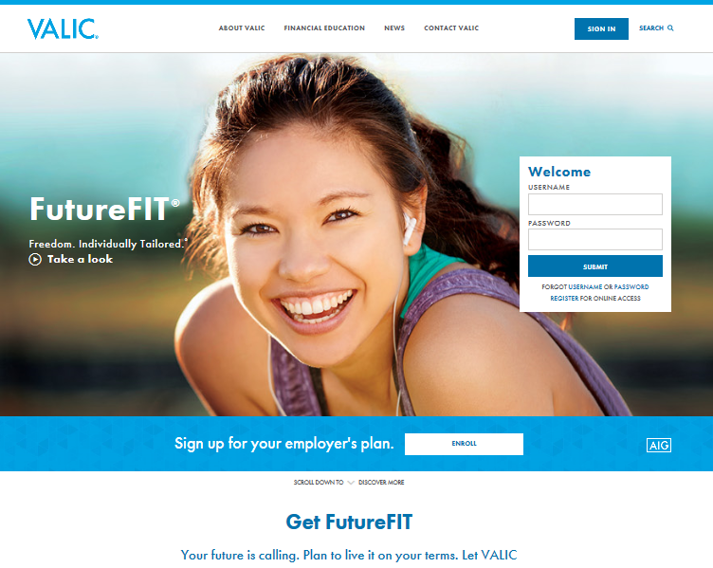
Enrolling in your workplace retirement plan
FutureFIT®
  Getting your financial future in shape
Digital portal for retirement plan
enrollment and planning
Provides financial guidance,
educational and financial tools
Notes:
[OPTIONAL]
FutureFIT is the VALIC digital experience designed to put you in charge of your financial future by simplifying and automating enrolling and managing your retirement planning.

Slide 36
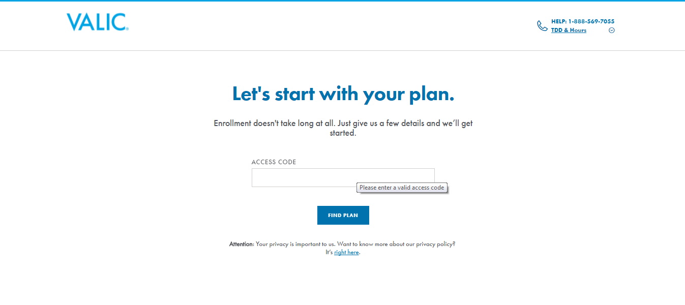
Enrolling in your workplace retirement plan
Getting FutureFIT: Access code
Notes:
[OPTIONAL]
Log in to your account on VALIC.com by entering the information requested. Once you click on “Find Plan,” the system will generate a list of plans available for enrollment.
[Optional information for groups offering the Quick Enroll option.]
If your plan offers the Quick Enroll option, you will be able to select a default deferral rate and a Qualified Default Investment Alternative (QDIA). Just select both defaults and you are automatically enrolled in these options. You will later provide your beneficiary information.

Slide 37
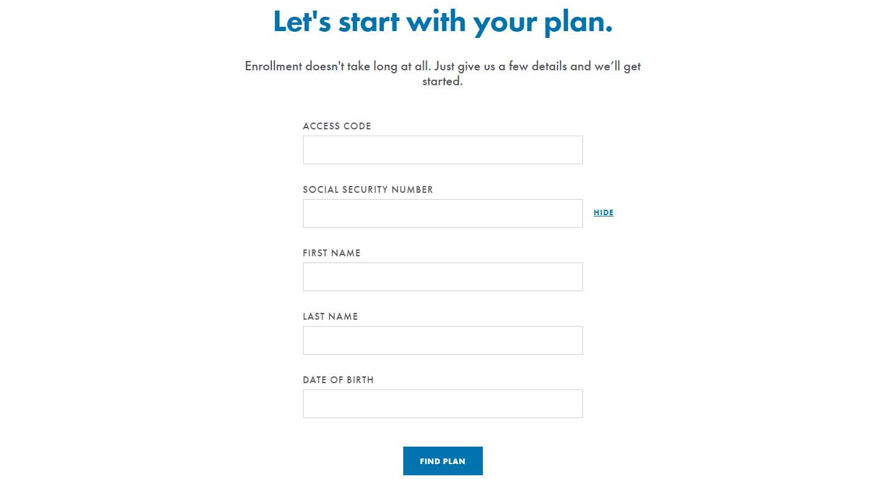
Enrolling in your workplace retirement plan
Getting FutureFIT: Enrollment Center
Notes:
[OPTIONAL]
Log in to your account on VALIC.com by entering the information requested. Once you click on “Find Plan,” the system will generate a list of plans available for enrollment.

Slide 38
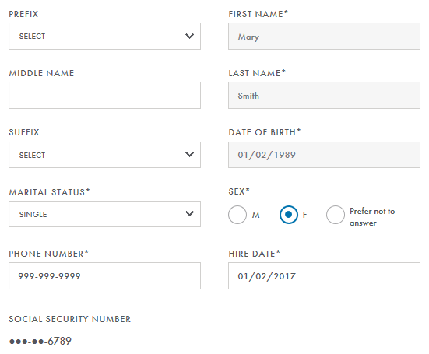
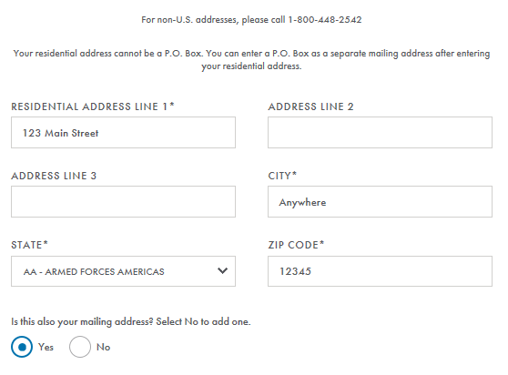
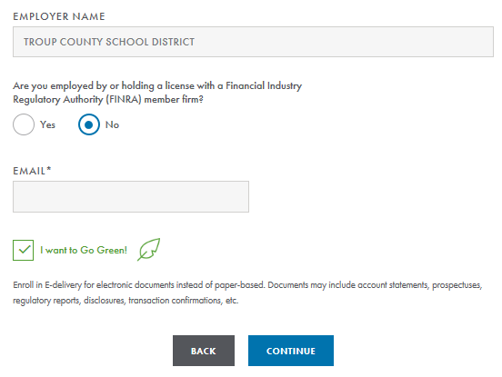
Enrolling in your workplace retirement plan
Step 1: About you - Provide personal contact information
123 MAIN St.
01-02-19XX
Anywhere
12345
Notes:
[OPTIONAL]
Once you have selected a plan, there are four easy steps to follow. First, enter your personal contact information.

Slide 39
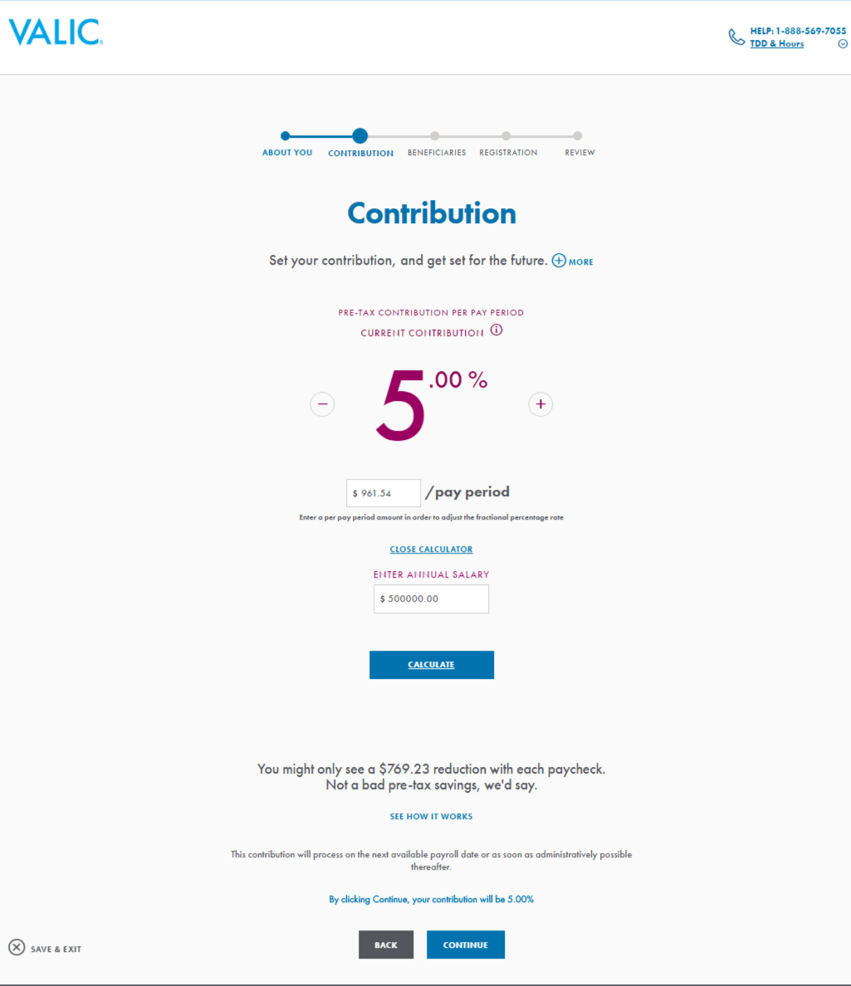
Enrolling in your workplace retirement plan
Step 2: Contribution - Enter your contribution election
Notes:
[OPTIONAL]
In step two, you will have the option of entering your contribution amount and how it should be allocated.

Slide 40
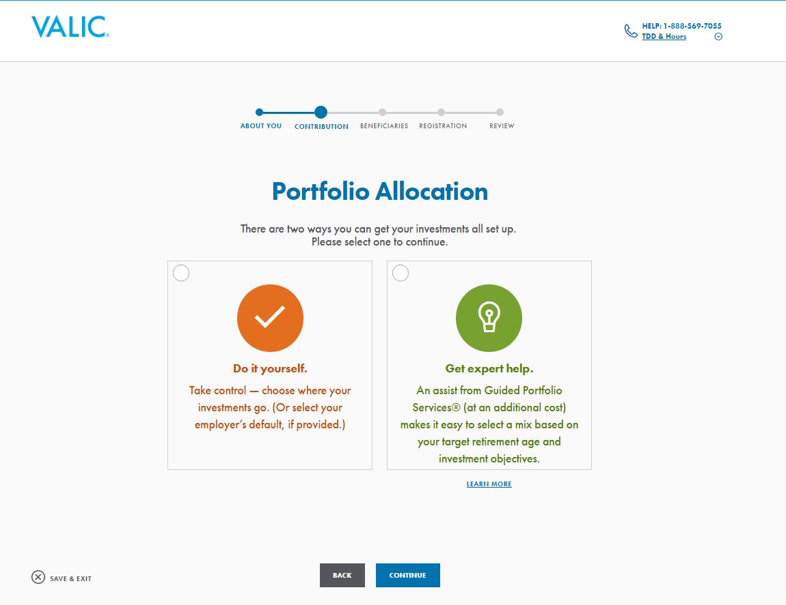
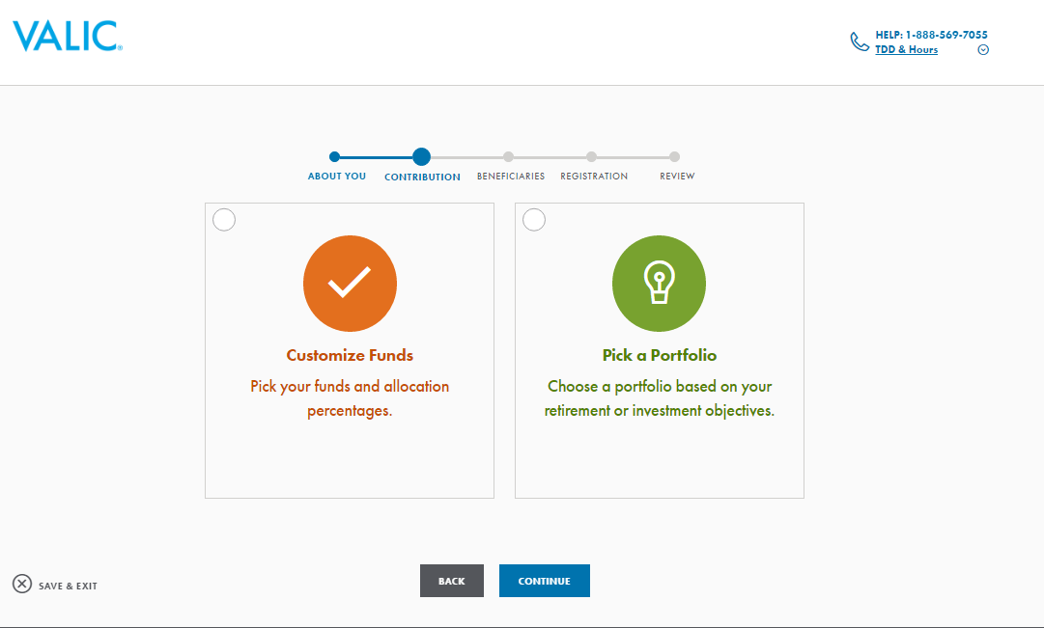
Enrolling in your workplace retirement plan
Step 3: Portfolio allocation
Notes:
[OPTIONAL]
In step three, if your plan offers Guided Portfolio Services® (GPS), you can sign up for it by selecting ‘Get expert help’. Selecting this notifies your financial advisor of the selection. Selecting ‘Do it yourself’ allows you to pick your own allocations.
Regardless of whether you choose ‘Do it yourself’ or ‘Get expert help’, you will need to choose allocations. If your employer’s plan is set up with models, you will be able to either select a portfolio or customize your own funds.

Slide 41
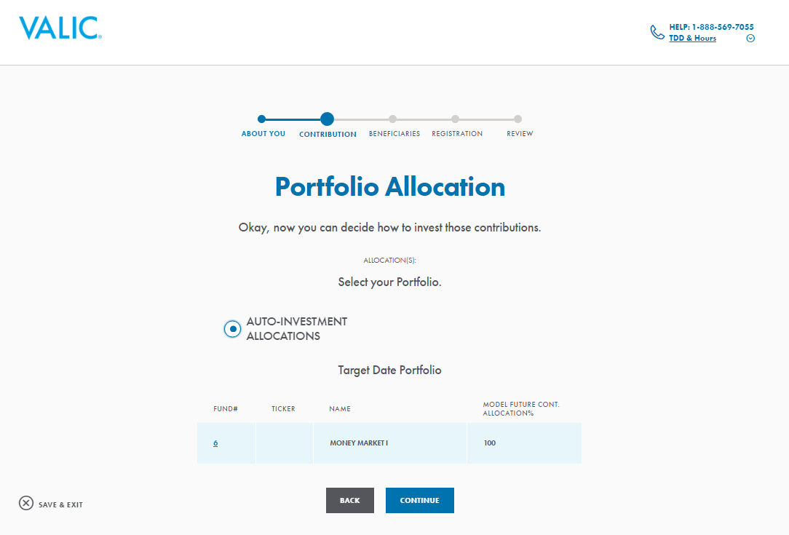
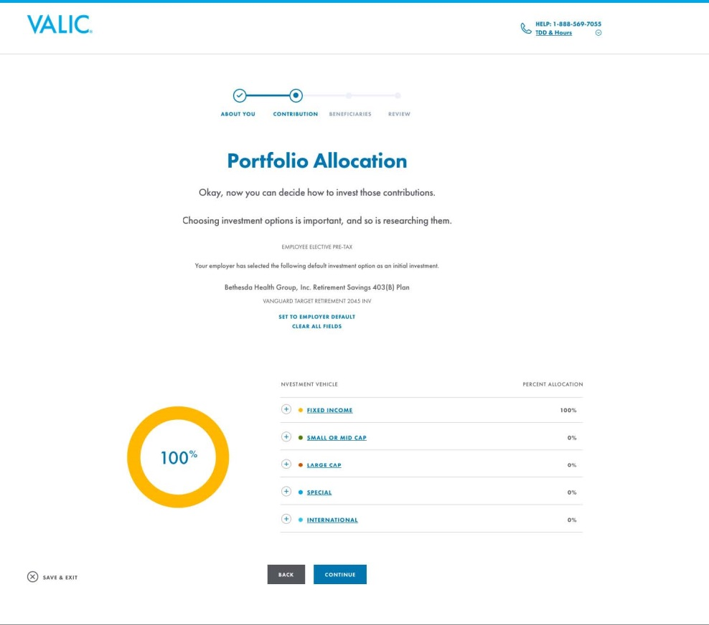
Enrolling in your workplace retirement plan
Step 3: Portfolio allocation
Notes:
[OPTIONAL]
If you selected ‘Pick a Portfolio’, you can choose one of the model portfolios in your plan.
When you elect to choose your own funds, you will be taken to the Portfolio Allocation page. Note that the allocations must equal 100%.

Slide 42
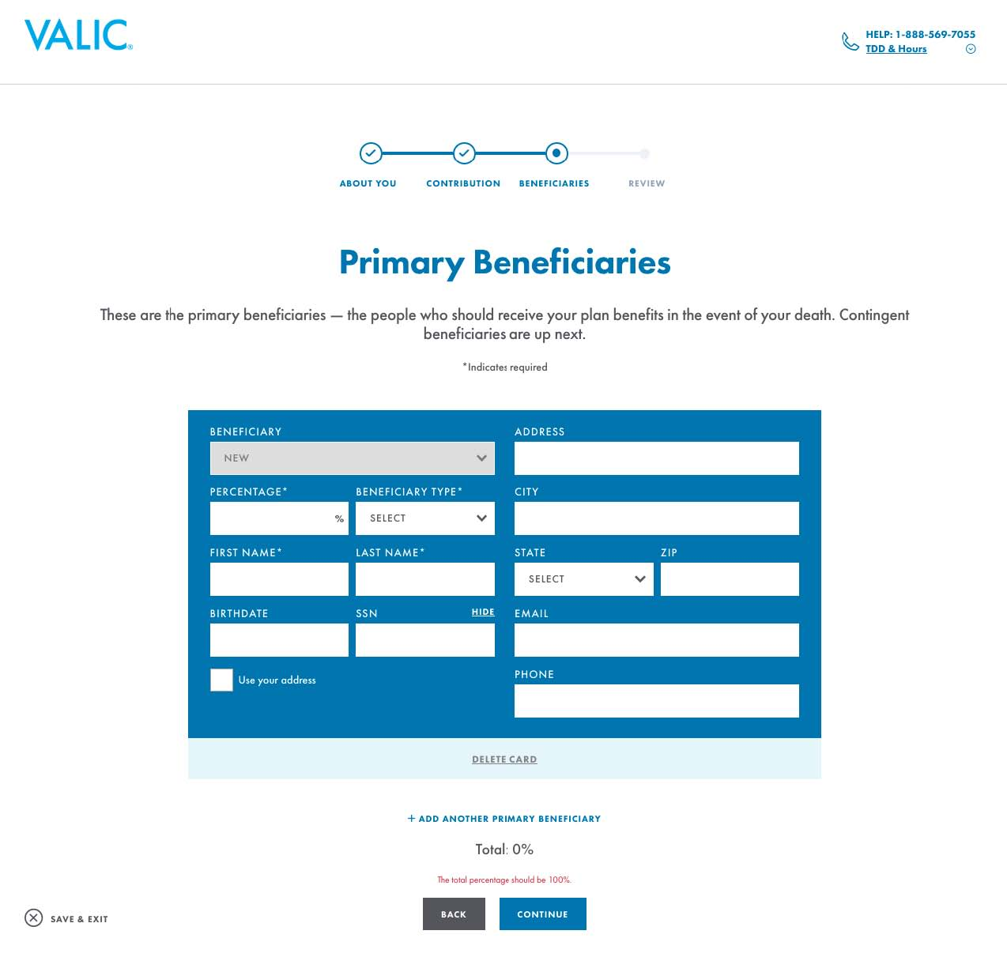
Enrolling in your workplace retirement plan
Step 4: Beneficiaries - Provide beneficiary information
Notes:
[OPTIONAL]
In step four, provide your primary and contingent beneficiary information. If you are married and allocate less than 50% to your spouse as a primary beneficiary, you will also need to submit a beneficiary designation form.

Slide 43
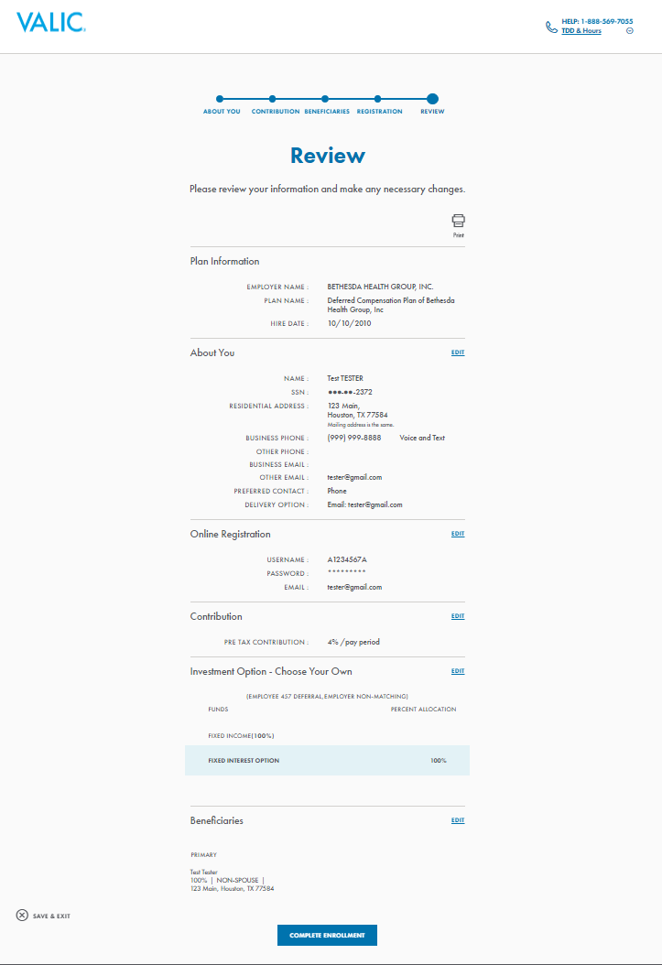
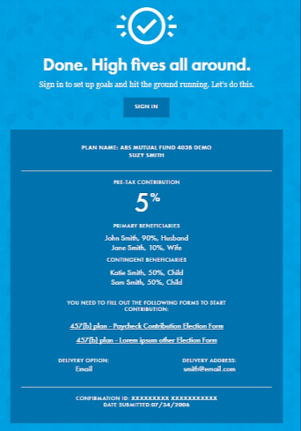
Enrolling in your workplace retirement plan
Step 5: Review - Ensure your information is correct
Notes:
[OPTIONAL]
The final step is to review your information to ensure it is correct. You will have an opportunity to edit your entries.

Slide 44
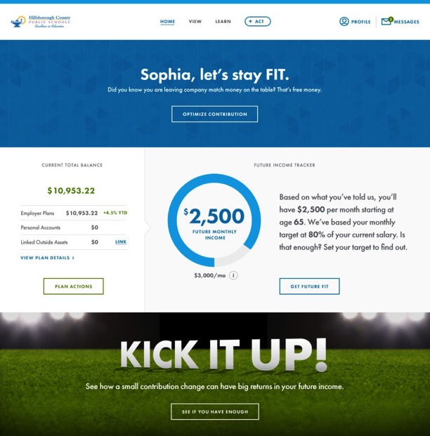
Enrolling in your workplace retirement plan
Post enrollment: FutureFIT Income Tracker
Access account information and tools
from your workspace
  Plan details
  Account balance
  FutureFIT calculator
  Smart videos that display
  personal information
  Curated educational content
  Perform change contributions
  Portfolio asset rebalancing
  …and much more
Notes:
[OPTIONAL]
Once enrolled and registered on VALIC.com, the FutureFIT Income Tracker allows you to view your account balance, change contributions, track future monthly retirement income, rebalance portfolio assets and much more…all from your workspace. It is all tailored just for you. In addition, you can access a smart video that engages you through the use of personalized retirement readiness information, as well as educational content that is relevant based on criteria such as age, gender, market sector, retirement readiness, and other key variables.
Let’s see how some of these features work.

Slide 45
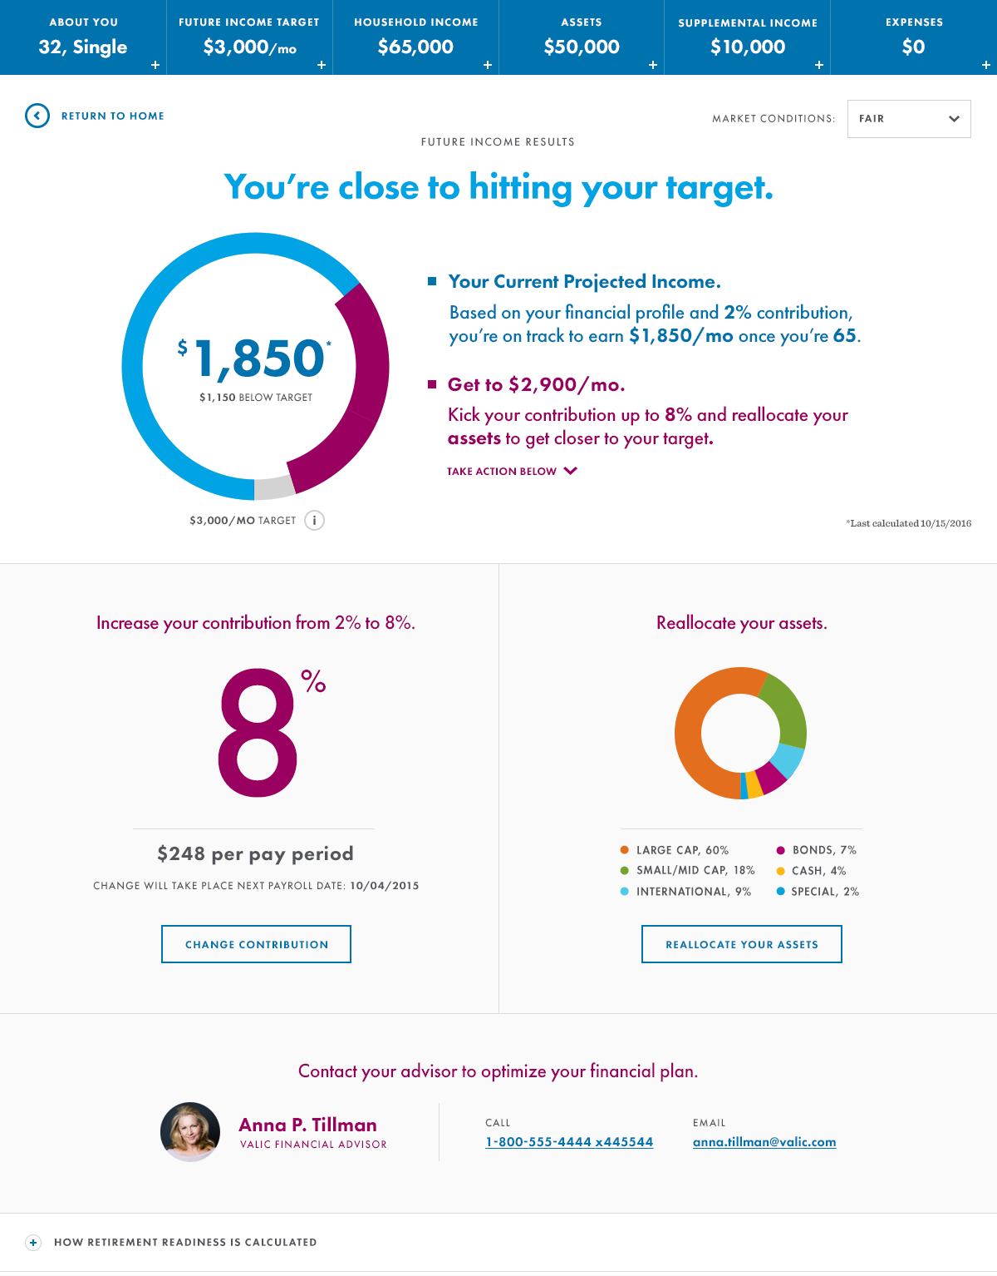
Enrolling in your workplace retirement plan
Post enrollment: Future Income Calculator
FutureFIT monthly income goal
established and gaps identified
Projection of future income
against the goal
Ability to add financial / spousal
information and refresh analysis
Guidance provided on deferral rate
and asset class-level investments
Each suggestion is actionable on
the same screen
Notes:
[OPTIONAL]
On the FutureFIT Calculator page, you can see a projection of where your future income stands now, as well as discover that a few small changes today make all the difference later.
In the top panels, you can see information that is being used to calculate projected future monthly income, with editing made simple through the use of a “+” sign drop-down. We make it easy to add outside assets or information about a spouse or partner. The calculation can then be refreshed in a matter of seconds.
If you’re not on track to reach your goals, FutureFIT will make suggestions for deferral amount and investments at the asset-class level. Each of these can be easily implemented by clicking on the action buttons.
While we empower you to take action, we want you to know that personal help is always available. You can easily connect with your financial advisor, and gain assistance through an email or direct call.

Slide 46
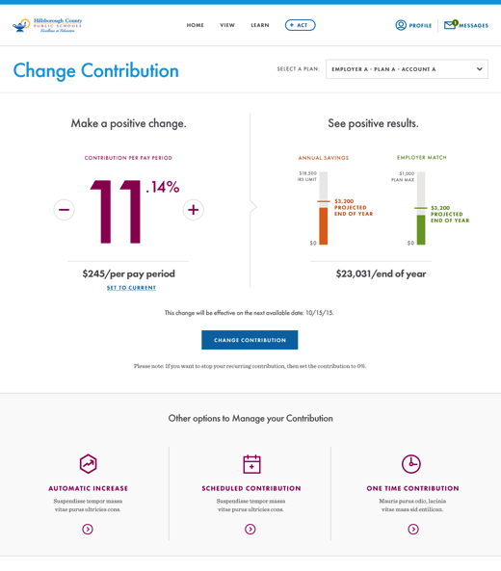
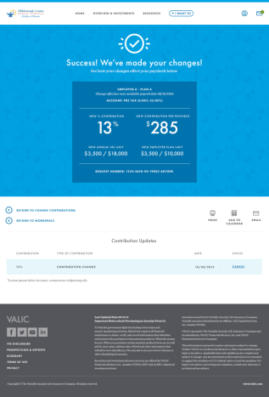
Enrolling in your workplace retirement plan
Post enrollment: Change contribution
Self-managed
contribution change
Instant calculation of
impact on paycheck
Ability to schedule
annual increase,
future-date increase,
or one-time
contribution
Confirmation page
Notes:
[OPTIONAL]
The VALIC site brings you tremendous flexibility in managing your contribution changes. You can quickly see how changing your contribution affects your paycheck and your year-end balance.
We begin by analyzing the impact of any desired change on your paycheck.
A contribution change can be scheduled for a future date, but we make additional options available.
If a sizeable deferral increase isn’t possible all at once, you can elect to increase by a percentage or two each year until you hit the desired level. Further, you may have a paycheck or two each year where other benefit program payments are not taken from your check. This could be a great time to schedule a one-time payment or increase to your retirement account.
Once changes are made, you receive a confirmation page which can be printed or shared with your advisor. And scheduling of changes is front and center in the online calendar.
Keeping up with your retirement contributions has never been easier.

Slide 47
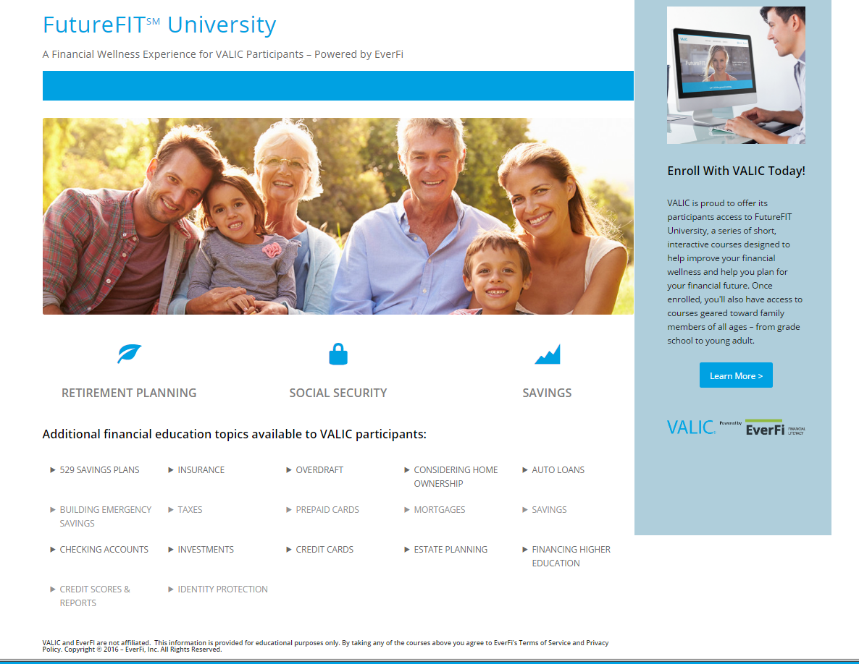
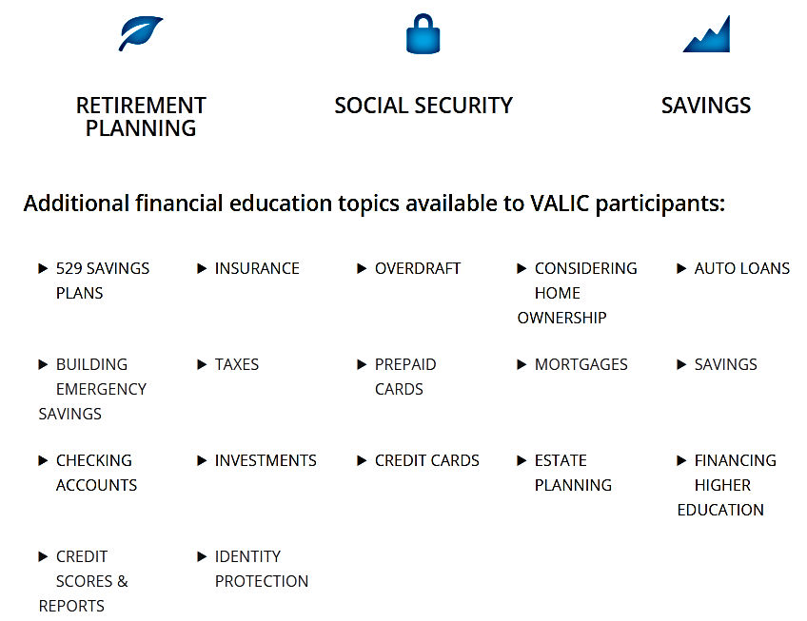
Enrolling in your workplace retirement plan
Resources: FutureFIT University
Notes:
[OPTIONAL]
Additionally, VALIC offers a wealth of online educational resources to assist you on your path to financial wellness.
On your FutureFIT University portal, you will be able to access information on retirement planning, savings, education planning, insurance, loans, credit protection and Social Security benefits, among other topics.

Slide 48
Putting it all together
Notes:
We’ve covered a lot of information today. Did the questions we posed at the start of the presentation get answered? Let’s review.

Slide 49

Putting it all together
Reviewing the basics
1
2
3
What generation
are you?
Why save for retirement?
Why participate in your retirement plan at work?
    Cultural experiences helped shape your views
    Retirement and
    your generation
    People are living longer
    More responsibility placed on personal savings
    Higher prices means less purchasing power
    It’s easy and automatic
    Tax-deferred growth
    Time is on your side
Notes:
What generation are you? The USA Today quiz showed us how cultural experiences help shape how we look at the world. And, we talked specifically about how each generation views retirement. What will retirement look like in your future? You may live to be 100! How will you pay for those extra years?
Why save for retirement? More responsibility is being placed on personal savings to provide a lasting source of income in retirement. An income-generating source is needed to help keep pace with inflation, otherwise higher prices could diminish your purchasing power in retirement. Also, as a guide, you could potentially need at least 80% of your last working year’s salary to maintain your lifestyle in retirement.
Why participate in your retirement plan at work? It’s easy and automatic. You can elect to save using salary deferrals in the amount you designate. And, that money compounds with interest, potentially growing tax-deferred until you retire. Time is on your side when you are working. And, the earlier you start saving the better—remember the cost of procrastination.
49

Slide 50
Putting it all together
Employer-sponsored retirement plan options
  Most common tax-qualified plan types
    403(b) Public schools and nonprofit
    457(b) Government and tax-exempt
    401(k) Non-governmental organizations
  Contributions and catch-up provisions
  Ordinary income taxes are due upon withdrawal
  10% federal early withdrawal tax penalty may apply if under age 59½*
  Choice of withdrawal methods
*The 10% federal early withdrawal tax penalty does not apply to 457(b) plans.
Notes:
What are the most common tax-qualified plans? They include the 403(b) for public schools and nonprofit organizations, 457(b) for government organizations, and the 401(k) for non-governmental employers.
They each allow substantial annual contributions and certain catch-up provisions for more savings opportunities.
Withdrawing from these plans requires considering the tax impact. Overall, taxes are due upon withdrawal and a 10% federal early withdrawal tax penalty may apply if you are under age 59½*, unless certain conditions are met.
Withdrawals can begin based on a triggering event like reaching age 59½*, severance from employment and death to name a few.
We also talked about the most common withdrawal methods: lump-sum cash withdrawal, systematic withdrawals, annuitization and rollovers.
*Remember, the 10% federal early withdrawal tax penalty does not apply to 457(b) plans.
50

Slide 51
Putting it all together
Enrolling in your employer’s retirement plan
  Five easy steps
1
2
3
4
5
ABOUT YOU
REGISTRATION
CONTRIBUTION
BENEFICIARIES
REVIEW
Notes:
There are five simple steps to enrolling in your employer’s retirement plan. By contributing to your plan now, you’re working to build income for a comfortable lifestyle in retirement. You can plan for your essential living expenses to be met.
51

Slide 52
Putting it all together
Work with VALIC Financial Advisors, Inc. (VFA)
  Develop an overall financial plan
Prioritize your investment and retirement goals
Determine the time horizon needed to achieve your goals
Determine a comprehensive financial strategy to help meet your goals
For more than half a century, VALIC has helped Americans plan for and enjoy a more secure financial future
Notes:
52
If what we’ve talked about today has you wondering how to get started, let us help.
Your VALIC financial advisor can help get your salary deferrals started contributing to your employer’s tax-qualified plan. He/she can also develop an overall financial plan to help you:
Prioritize your investment goals
Determine the time horizon needed to achieve your goals
Determine a financial strategy to help meet your goals
VALIC is a leading provider of retirement plans and investment services.* Our longevity and wide range of investment options means that we’ve helped hundreds of thousands of people, just like you, plan for and enjoy retirement. Most importantly, through our experience, our goal is to help you live retirement on your terms.
*Source: LIMRA, SRI Not-for-Profit Retirement Market Survey, 12/31/2016. Based on total assets in a survey of 25 major companies.

Slide 53
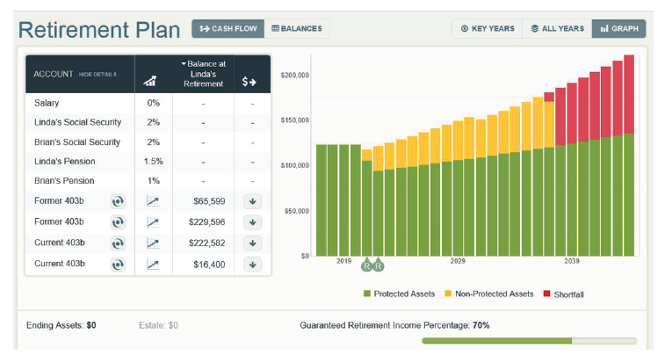
Putting it all together
Retirement Pathfinder®
  Get real-time answers to your questions:
Can I retire when I planned?
How much monthly income
will I need?
Am I currently saving enough?
Is it possible to guarantee my
retirement income?
Will I outlive my retirement
savings?
What happens if I die prematurely?
Notes:
53
[OPTIONAL Slide.]
Retirement Pathfinder from VALIC is an interactive retirement income planning tool that can help you see your retirement plan like you’ve never seen it before. It is designed to dynamically build your retirement plan while sitting shoulder-to-shoulder with your financial advisor. Retirement Pathfinder can illustrate numerous retirement scenarios and can identify potential retirement pitfalls.
In just minutes I can start generating the answers you need to determine where you stand and where you might need to make changes. This can provide clarity about your progress, choices for creating adequate retirement income and confidence in your plan. Please check “yes” on your Evaluation Form if you would like to learn more.

Slide 54
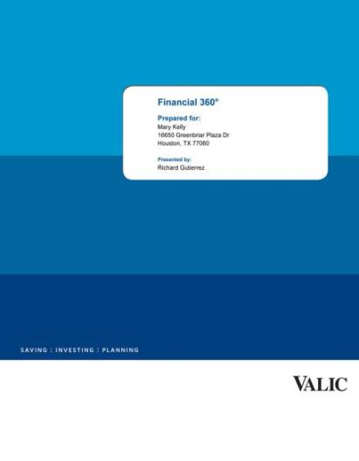
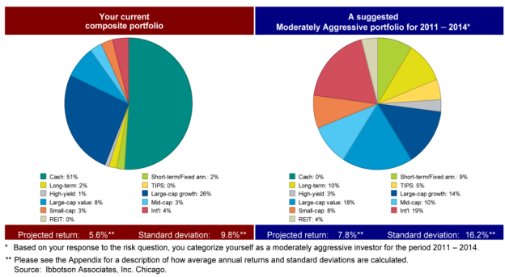
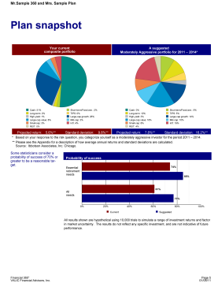
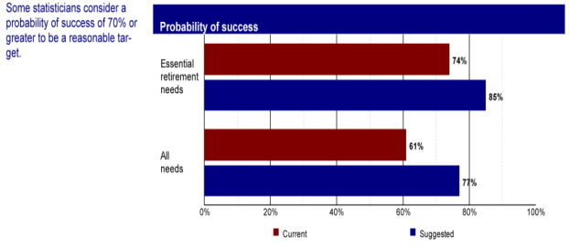

Putting it all together
Financial 360 Plan
  Provides a customized analysis of your financial situation
Notes:
[OPTIONAL Slide.]
Once you’ve consulted with a VALIC financial advisor, he/she can create a customized plan for you. The Financial 360 Plan provides a side-by-side comparison of your current asset allocation and a suggested, diversified investment program based on information you provide. It is also designed to recommend how to overcome the five major risks in retirement, which are inflation risk, longevity risk, investment risk, healthcare costs and withdrawal risks. Investment efficiency and its impact on retirement are also addressed.

Slide 55

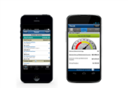

Putting it all together
Access anywhere
VALIC mobile
Track your account
Research
and news
Contact your financial advisor
Tablet app
iPad®
Smartphone apps
iPhone® and Android™
Mobile browsing
VALIC Mobility
iPad and iPhone are registered trademarks of Apple Inc. Android is a trademark of Google Inc.
55
Notes:
VALIC offers easy access to your account information … anytime and anywhere.
Use the VALIC Mobile app from your tablet or smartphone to track and monitor your account, do research, view real-time news and market quotes, and even contact your financial advisor directly from the app – simply click the number to dial.

Slide 56
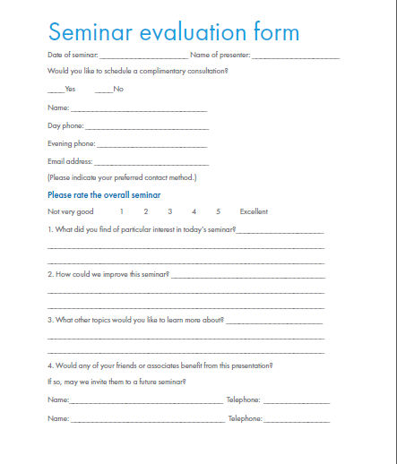
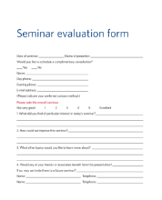
Putting it all together
Evaluation
Notes:
[This slide has automatic animations.]
Thank you so much for your time today. Please take a moment now to complete the evaluation form. Your feedback is very important to me. If you would like to set up an appointment with me, check the box on the evaluation and I will contact you within 48 hours. Also, included in your workbook is a helpful checklist you can use to start the process of figuring out your finances. If you set an appointment with me, you can bring it with you.
Thanks again!

Slide 57




This information is general in nature, may be subject to change, and does not constitute legal, tax or accounting advice from any company, its employees, financial professionals or other representatives. Applicable laws and regulations are complex and subject to change. Any tax statements in this material are not intended to suggest the avoidance of U.S. federal, state or local tax penalties. For advice concerning your individual circumstances, consult a professional attorney, tax advisor or accountant.
Securities and investment advisory services offered through VALIC Financial Advisors, Inc. (“VFA”), member FINRA, SIPC and an SEC-registered investment advisor. VFA registered representatives offer securities and other products under retirement plans and IRAs, and to clients outside of such arrangements.
Annuities issued by The Variable Annuity Life Insurance Company (“VALIC”). Variable annuities distributed by its affiliate, AIG Capital Services, Inc. (“ACS”), member FINRA. VALIC, VFA and ACS are members of American International Group, Inc. (“AIG”).
American International Group, Inc. (AIG) is a leading global insurance organization. Founded in 1919, today AIG member companies provide a wide range of property casualty insurance, life insurance, retirement products and other financial services to customers in more than 80 countries and jurisdictions.
Copyright © The Variable Annuity Life Insurance Company.
All rights reserved.
VALIC.com
VC 23890 (12/2017) J102960 EE

Slide 58
Your Retirement Plan at Work
Photo collage
Helping you prepare for a more fit retirement journey
Thank you!

