Slide 1

New Employee Orientation
Benefits: Insurance (Part 1)
UCF Human Resources Benefits Section
(407) 823-2771
Benefits@ucf.edu

Slide 2

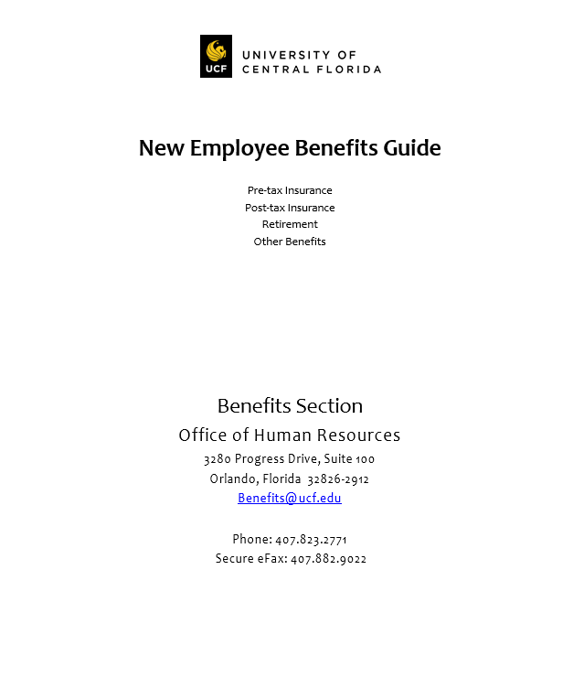
New Employee Benefits Guide
Please ensure you have access to the New Employee Benefits Guide, which is used in conjunction with New Employee Orientation.

Slide 3


Who is People First?
Because UCF is a state university, we participate in the State Group Insurance Program. People First is the plan administrator for the State Group Insurance Program. They are responsible for plan enrollments, determining eligibility, processing changes and COBRA.
Using People First to Enroll
Online: https://peoplefirst.myflorida.com
User ID and Password Required
Service Center: 1-866-663-4735
    Available Monday-Friday 8:00am to 6:00pm ET
  If you are transferring from another State Agency or State University, you will use your new People First ID when calling People First.

Slide 4


Default password: Pf + Birth date (PfMMDDYY)
Enter ID and Password
  If you are transferring from another State Agency or State University, you will use your old (original) People First ID to log into the People First website.

Slide 5
Changing Insurance
Employees have two ways to change insurance elections after 60-day new hire enrollment window:
Qualifying Status Change (QSC)
  Marriage, divorce, birth of child, spouse insurance termination, etc.
  Employees have 60 days from event to contact People First
Open Enrollment
  Held each fall
  Coverage effective January 1st of following year

Slide 6


Eligible Dependents
  Spouse
      If you and your spouse are state employees, you can participate in the Spouse Program and pay less for health insurance at a reduced premium. To enroll in the Spouse Program, you must complete and sign the Spouse Program Election Form within 60 days of becoming eligible.
      *Form available here: http://mybenefits.myflorida.com/health/eligibility/spouse_program
  Children (up to age 26)
    May be eligible until 30 if they meet certain criteria: Unmarried, no dependents of their own, are dependent on you for financial support, live in Florida or attend school in another state and have no other health insurance.
    Children with Disabilities may be covered after age limit if they meet certain criteria.
          Additional documents will be requested by the Division of State Group Insurance (DSGI) to confirm dependent eligibility. A list of all required documents can be found on the Dependent Eligibility Verification page of the myBenefits website: http://mybenefits.myflorida.com/health/dependent_eligibility_verification
Notes:
FOR CHILDREN UP TO AGE 26:
For a child, stepchild, or adopted child: A copy of the child’s government-issued birth certificate or adoption certificate naming you or your spouse as the child's parent. Please note the document must list the first and last name of the child and parent(s).
For a child in your custody or under your guardianship: A copy of the court order naming you or your spouse as the child’s legal guardian or custodian.
For a foster child: A copy of the records showing you or your spouse as the dependent’s foster parent.
For a newborn child of a covered dependent up to age 18 months: A copy of the newborn’s government-issued birth certificate listing your covered dependent as the birth parent.
FOR UNMARRIED CHILDREN AGE 26 TO AGE 30:
A copy of the child’s government-issued birth certificate or adoption certificate naming you or your spouse as the child's parent. Please note the document must list the first and last name of the child and parent(s); OR a copy of the court order naming you or your spouse as the child’s legal guardian or custodian; AND
A copy of the Affidavit of Adult Child (can be downloaded from https://www.mybenefits.myflorida.com/health/dependent_eligibility_verification), AND
One of the following documents:
o A document confirming the child’s enrollment as a student in the current Spring, Summer, or Fall semesters. The document must include the name of the child, the name of the school, and the school term; OR
o A bill or statement in the child’s name that is dated within the past 60 days and is mailed to the child at a Florida address.
FOR DISABLED CHILDREN AGE 26 AND OLDER:
A copy of the child’s government-issued birth certificate or adoption certificate naming you or your spouse as the child's parent. Please note the document must list the first and last name of the child and parent(s); OR a copy of the court order naming you or your spouse as the child’s legal guardian or custodian, AND
A Tax Return Transcript of your most recently filed federal tax return listing:
o The child’s name and the last four digits of the child’s Social Security number; AND
o The child as your tax dependent. The tax return transcript can be obtained from www.irs.gov/individuals/get-transcript or by calling the IRS at 800-908-9946.
*If you are covering a stepchild or a child for whom your spouse has legal guardianship, you must also provide documentation of your current relationship to your spouse, as requested above.

Slide 7
Insurance Effective Dates
Employees have 60 days from hire date to enroll in insurance
Employees in regular positions may elect health insurance to begin the month after they are hired – this is called an early effective date
  For example, if you are hired in June, you can start your health insurance July 1.
Insurance cards will be mailed after effective date

Slide 8
Health Insurance Options
2 Options Available: | Option 1: Standard Option | Option 2: HDHP Option (High Deductible Health Plan)
2 Options Available | Option A: HMO Reference map in Benefits Guide for specific providers by county In-Network Only (Open Access) Copayments Option B: PPO Florida Blue (Blue Cross Blue Shield) Choice of Network/Non-Network Deductible, Copayments & Coinsurance | Option A: HMO Reference map in Benefits Guide for specific providers by county In-Network Only (Open Access) Deductible & Coinsurance Option B: PPO Florida Blue (Blue Cross Blue Shield) Choice of Network/Non-Network Deductible & Coinsurance
Monthly Premium Premiums are listed for full time employees 9-Month Faculty will be double deducted during Spring months to pay for Summer coverage | Individual: $50.00 Family: $180.00 Spouse Program: $15.00/Each Employee | Individual: $15.00 Family: $64.30 Spouse Program: $15.00/Each Employee
Deductible | HMO: None PPO: $250 Individual / $500 Family | HMO: $1,350 Individual / $2,700 Family PPO: $1,350 Individual / $2,700 Family
Notes |  | Employee assumes greater responsibility with health care Participation in Health Savings Account (HSA) to offset out of pocket expenses
Notes:
Briefly go through what a premium, copay, deductible and coinsurance is.

Slide 9


Prescription Drug Plan:
 | Standard HMO & Standard PPO |  | HDHP HMO & PPO
 | Retail (30 Day Supply) | Mail Order & Retail (90 Day Supply) | Retail (30 Day); Mail Order (90-Day); Retail (90-Day) *After deductible
Generic | $7 | $14 | 30%
Preferred Brand-Name | $30 | $60 | 30%
Non-Preferred Brand-Name | $50 | $100 | 50%
You will receive a separate prescription card from CVS Caremark. Your health insurance card is not used for prescriptions.
Medication Synchronization (Med Sync) allows prescriptions to be synchronized so they can be refilled on the same day. This is optional and only allowed once per year. If you are interested, speak to your pharmacist.
  Download CVS Caremark’s smartphone app to manage your account, see your ID card and more!

Slide 10


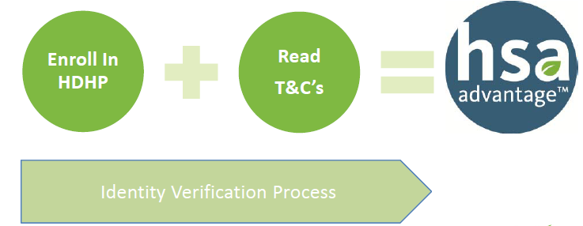
HDHP: Health Savings Account
Allows you to use pretax dollars to pay your share of the cost for eligible medical, prescription, dental or vision care services not covered by your insurance plans
You do not need to worry about “use it or lose it” rules because unused HSA account balances “carry forward”
Your account balance is yours if you leave UCF, and you can continue to use it tax-free for healthcare expenses or roll it over to another HSA.
  2 Steps to open HSA AdvantageTM bank account:
  *In some instances, Chard Snyder will request additional information to open your account.
Under “HDHP” plans, you are responsible for 100% of medical bills and prescription costs until annual deductible has been met.
 | UCF Contributes | Employee Can Add: | Total Contributions (UCF + Employee Contributions)
Employee Only | Up to $500/Year | Up to $2,950/Year Tax Free | …up to $3,450/Year
Family Coverage (Employee + Dependents) | Up to $1,000/Year | Up to $5,900/Year Tax Free | …up to $6,900/Year

Slide 11
Spending Account Comparison
 | Health Care FSA | LIMITED PURPOSE FSA | Dependent Care FSA
Enroll if you have: | Standard PPO or HMO No health coverage | Any High Deductible Health Plan (HDHP) | Eligible expenses for “day care” for an eligible child or qualifying relative so you can work
How much you can contribute (Pretax): | $60: Minimum/Year $2,650: Maximum/Year | $60: Minimum/Year $2,650: Maximum/Year | $60: Minimum/Year $5,000: Maximum/Year Household
Use the account to pay yourself back for: | Expenses not paid by insurance or reimbursed from any other source. Examples: Deductibles Copayments Dental & Vision Expenses Orthodontia not covered by dental plan | Not available for medical expenses. Other expenses not paid by insurance or reimbursed from other source. Examples: Dental & Vision Expenses Not paid by insurance or reimbursed from any other source | Care for a child, disabled spouse or qualifying relative who: is dependent on you needs care so that you (and your spouse if you're married) can work Examples: Daycare Elder Care
Balance Information: | Full balance is available immediately |  | Accumulated balance
Payment Card: | Benny© card
Deadline to Use Funds: | December 31st is the last day to incur claims for each plan year, and you must submit all claims by April 15th of the following year. Otherwise, if you have funds remaining at the end of each plan year, a maximum of $500 will carry over to the next plan year while any funds in excess of $500 will be forfeited. |  | “USE IT OR LOSE IT” Rule: Grace period to use funds ends March 15th and you must submit all claims by April 15th of the next plan year.

Slide 12

Dental
To Choose a Dental Plan:
  Compare the four dental plan options–Prepaid (HMO), Preventive PPO, Standard PPO, and Indemnity with PPO.
  *See chart on the next slide for a side-by-side comparison.
  Confirm your dentist and dental specialists participate in your plan’s network and accept the specific plan.
  Think about your likely dental care needs for the coming year and compare your current costs for that care and your cost for coverage under the different plan options.
  Read the dental plan documents or call the insurance companies for specific questions you have about coverage.

Slide 13
 |  |  | Monthly Premiums
Type of Dental Plan | Plan Code | Plan Name | Employee Only | Employee + Spouse | Employee + Child(ren) | Employee + Family
Prepaid Dental Plan Pays benefits only when you use network providers. No deductible or annual maximum Most preventive care at no charge You pay a fixed copayment for dental procedures listed on the copayment schedule. Orthodontia: Covered for adults and children. | 4034 | CIGNA Prepaid Dental | $24.01 | $47.31 | $56.41 | $72.06
 | 4025 | Sun Life Prepaid Dental | $14.93 | $25.17 | $33.26 | $43.54
 | 4044 | Humana Select 15 Prepaid Dental | $12.64 | $21.20 | $23.00 | $32.98
PPO Dental Plan Receive care from any dentist Your cost is lower when you use network dentists You generally have an annual deductible to meet before the plan starts paying benefits, and then you pay part of the cost for the services you receive. Orthodontia: Covered for adults and children (excluding Preventive PPO). | 4023 | Ameritas Preventive | $22.84 | $43.20 | $46.24 | $67.76
 | 4033 | Metlife Preventive | $21.98 | $40.64 | $45.42 | $65.94
 | 4022 | Ameritas Standard | $31.50 | $59.04 | $66.08 | $96.22
 | 4032 | Metlife Standard | $32.08 | $59.34 | $66.32 | $96.28
Indemnity with PPO Dental Plan Receive care from any dentist Your cost is lower when you use network dentists You generally have an annual deductible to meet before the plan starts paying benefits, and then you pay a percentage of the cost for the care you receive. Orthodontia: Child only orthodontia covered by Sun Life. | 4021 | Ameritas Indemnity | $37.96 | $70.40 | $80.16 | $115.76
 | 4031 | Metlife Indemnity | $45.50 | $84.16 | $94.04 | $136.52
 | 4074 | Sun Life Freedom Advance | $43.55 | $83.61 | $98.83 | $130.35
Indemnity Dental Plan Receive care from any dentist You have a deductible to meet and then pay part of the cost for the services you receive. | 4084 | Humana Schedule B | $14.74 | $21.96 | $23.30 | $37.10

Slide 14

Vision:
Plan Type | In Network | Out of Network
Exams Every | 12 months
Lenses Every | 12 months
Frames Every | 24 months
Eye Exam | 100% after you pay $10 copay | $40 allowance
Lenses | Single: 100% after $10 copay Bifocal: 100% after $10 copay Trifocal: 100% after $10 copay | Single: $40 allowance Bifocal: $60 allowance Trifocal: $80 allowance
Scratch Resistant Lenses | $25 allowance | Not Covered
Anti-Reflective Lenses | $50 allowance | Not Covered
Frames | $75 wholesale allowance | $60 retail allowance
Contact Lenses | Elective: $150 allowance Medically Necessary: 100% | Elective: $75 allowance Medically Necessary: $100 allowance
LASIK | Receive a 25% discount off the usual and customary price or 5% off advertised promotions for LASIK services from in-network providers. Discount covers consultations, laser procedure, follow-up visits and any additional necessary corrective procedures.
Monthly Premiums | Employee Only: $6.96 Employee + Spouse: $13.74 Employee + Children: $13.60 Family: $21.36

Slide 15


State Life Insurance:
 | Employee Life Insurance |  | Dependent Life Insurance
Plan Type | Basic Group Term Life | Optional Term Life | Dependent Spouse Life | Dependent Child Life
Guaranteed Issue (no medical underwriting)? | Yes | Up to the lesser of five times annual salary or $500,000, if elected within 60 days of initial eligibility | If elected when spouse becomes eligible. Medical Underwriting to elect or increase coverage after the initial eligibility period is required. | Yes
Value | $25,000 | 1x – 7x Annual Salary *Maximum Benefit of $1,000,000 | $15,000 or $20,000 | $10,000
Premium | No Cost to Regular Full Time Employees Part Time Employees Pay Prorated Premiums Based on FTE | Employee Pays 100% of Premium Visit Securian website for premium calculator | Employee Pays 100% of Premium $4.50/Month = $15k Coverage $6.00/Month = $20k Coverage | Employee Pays 100% of Premium $0.85/Month
You may increase your existing Optional Group Term Life coverage by one level of annual earnings during Open Enrollment or following a qualified status change up to the lesser of five times annual salary or $500,000, on a guaranteed issue basis.
Complete Beneficiary Designation Online (via People First website)

Slide 16
Other Supplemental Plans
Plan Type | Type of Benefit | Offered Through
Accident | Specified benefit amount(s) payable directly to insured for covered accidents in which a doctor’s office or hospital is visited for treatment of an accidental injury. Additional payments for follow-up visits and when crutches, wheelchairs or other covered medical aids are needed for covered accidental injuries. Covers work and non-work related accidental injuries. | Colonial Insurance Company (888) 756-6701
Cancer | Specified benefit amount(s) payable directly to insured for cancer screenings, diagnosis and treatment. Utilize benefit payments as needed. Benefit amounts dependent upon coverage level selected. | AFLAC (through Capital Insurance Agency) (800) 780-3100 Colonial Insurance Company (888) 756-6701
Disability | Supplements income loss during short-term disability to help pay living expenses. Can choose elimination period for accident and sickness related disabilities based upon need. | Colonial Insurance Company (888) 756-6701
Hospitalization | Specified payment amounts directly to covered individual when hospitalized. Additional payments, depending on coverage selected, for ancillary services related to hospitalization. | Cigna Health & Life Insurance Company (CHLIC), through Capital Insurance Agency (800) 780-3100 New Era (800) 277-2300
Hospital Intensive Care | Daily benefit for confinement in a hospital intensive care or a sub-acute intensive care unit. | AFLAC (through Capital Insurance Agency) (800) 780-3100
After People First enrollment, you must contact an agent to complete an application for your enrollment to be complete.

Slide 17


Additional post-tax options available through The Gabor Agency:
    Long Term Disability
    Life Insurance
Employees may cancel plans at any time
How To Enroll:
  Contact local Gabor Representative: (800) 330-6115
  http://www.gaboragency.com/schools/university-central-florida

Slide 18

Disability Plan Comparison
 | Enroll via People First (Colonial) | Enroll via The Gabor Agency (The Standard)
New Hire Enrollment Deadline | 60 days | Guaranteed Issue if enrolling within 90 days of eligibility
Premium Deductions | Pre-Tax *When you receive your benefit, it is taxed. | Post-Tax *When you receive your benefit, it is not taxed.
Benefits Pay After | 0, 7, 14 or 30 days | 30 or 90 days
Maximum Benefit Period | 12 Months | Until Social Security Normal Retirement Age, as long as you are still disabled
Monthly Premium Amount | Price based on the benefit amount and period elected. Minimum: $17.50/Month Maximum: $114.00/Month *If your annual salary is over $62,800, your benefits are capped at $3,480/Month. | 30 Day Plan: Your Monthly Salary/100 * $0.85 90 Day Plan: Your Monthly Salary/100 * $0.59 *If your annual salary is over $300,000, your benefits are capped at $15,000/Month.
How To Enroll | Enroll on the People First website and meet with a Colonial Life Benefits representative | Submit application to UCF Human Resources Benefits Section via email (Benefits@ucf.edu), Fax (407-882-9022) or drop off

Slide 19
Life Insurance Comparison
 | Enroll via People First | Enroll via The Gabor Agency
 | Optional Term Life (Securian) | Level Term Life (Symetra) | Group Term Life (The Standard) | Permanent Life [Universal Life UL-G] (Symetra)
New Hire Enrollment Deadline | 60 Days | N/A (fully underwitten) | 60 Days | N/A (full underwitten)
Coverage Amounts | 1x to 7x Salary | 10-Year Term 15-Year Term 20-Year Term 30-Year Term | Lesser of $200,000 or 4x Salary | Minimum $50,000
Maximum Limits | $1 Million | Contact The Gabor Agency | $200,000 for Employee Up to $50,000 for Spouse | Contact The Gabor Agency
Coverage Guarantee Issue | Yes | None- Fully Underwritten | Yes (if elected within first 60 days) | None- Fully Underwritten
Portable | No | Yes | Yes | Yes
Can Premiums Increase | Yes | No | Yes | No (as long as premiums paid on time)
Policy is good for | No limit | Length of the term | No limit | No limit
Important Note | Premiums increase when salary increases or every 5 years when milestone birthday age is reached. | Premiums are fixed once locked in for 10, 15, 20, and 30 year coverage. Contact Gabor regarding coverage ranges. | This policy is offered Guaranteed Issue with no medical exam required during the first 60 days of employment or during periodic open enrollments up to four times annual salary with a maximum limit of $200,000. Employee spouses are also eligible for guaranteed coverage up to $50,000 if payroll deducted. | This policy offers a Chronic Illness Rider. Up to 50% of the Policy's death benefit can be accessed in advance if a chronic illness applies.

Slide 20
Additional Employee Benefits
Tuition Waiver Program
  (6) Credit Hours Per Semester
  Employee can transfer credit hours to spouse and/or dependent children
  UCF Classes Only
  *OPS, Medical Residents & Post-Docs are not eligible for the Tuition Waiver benefit.
Florida Pre-Paid College Plan
  Available via payroll deduction
Public Service Loan Forgiveness Program
  Administered through the U.S. Department of Education
For additional information:
http://hr.ucf.edu/current-employees/benefits/additional-employee-benefits/
https://hr.ucf.edu/current-employees/benefits/health-wellness-resources/

Slide 21

Annual Events
Financial Wellness Series: Spring (April)
  Presentations throughout the month
Benefits Fair: Fall (October)
  Insurance & Retirement vendors available
  Learn about benefit changes for the upcoming year

Slide 22
Workers’ Compensation
  DO NOT SEE PERSONAL DOCTOR IF INJURED ON THE JOB!
These injuries are not covered by regular medical insurance
Supervisor and employee must report to AmeriSys ASAP
(800-455-2079), whether or not medical treatment is desired
The call to AmeriSys and a “UCF Report of Accident/Near Miss” form must be completed
Questions:
Contact Human Resources Leave of Absence/Workers’ Compensation Section at loaandworkcomp@ucf.edu or
407-823-2771
Notes:
AmeriSys is the medical case manager for all UCF Workers’ Comp claims; they will tell an injured employee where to go to receive care. The employee is not required to go to the Doctor. They are required to report work related accidents.

Slide 23

Sick Leave Pool
Eligibility
Employed with UCF for more than (1) year
Must have at least 64 hours of unused sick leave
Donate 16 hours to the Sick Leave Pool
Open Enrollment Period
March & September
Questions regarding the Sick Leave Pool should be referred to the Human Resources Leave of Absence & Workers Compensation Section (loaandworkcomp@ucf.edu).
Notes:
A 16-hour contribution to the sick leave pool allows employees who are enrolled in the sick leave pool a chance to have up to a maximum of 12 weeks PAID leave when you need it most.

Slide 24
FMLA (Family Medical Leave Act)
Rights & Responsibilities
Employees who are out for a period greater than (10) days due to medical reasons must request a medical leave of absence.
Absences cannot be counted against employees for attendance or disciplinary purposes if the employee’s leave of absence is designated FML (Family Medical Leave).
To be entitled to FMLA leave, the employee must:
  Be employed with the University for (1) year; and
  Have worked 1250 hours in the 12-month period prior to their leave.
Questions regarding FMLA should be referred to the Human Resources Leave of Absence & Workers Compensation Section (loaandworkcomp@ucf.edu).

Slide 25
New Employee Orientation
Benefits: Retirement (Part 2)
UCF Human Resources Benefits Section
(407) 823-2771
Benefits@ucf.edu

Slide 26
Mandatory Retirement Plans
FRS - Pension Plan
  Defined Benefit
FRS - Investment Plan
  Defined Contribution
State University System Optional Retirement Program (SUSORP)
  Defined Contribution
  College of Medicine Faculty = Mandatory
  FICA Alternative Plan (FAPLAN)
  Mandatory & Automatic for all OPS Non-Students, Adjunct Faculty, Post-Doctoral Associates and Medical Residents
FRS 2nd Election:
One-time opportunity to change from your current FRS retirement plan to the other as a Florida Retirement System (FRS) member (for example, transferring from the Pension Plan to the Investment Plan, or from the Investment Plan to the Pension Plan). Additional information is included in the Benefits Guide.
Notes:
Defined Benefit Plan: A type of pension plan in which an employer promises a specified monthly benefit on retirement that is predetermined by a formula based on the employee's earnings history, tenure of service and age, rather than depending directly on individual investment returns.
Defined Contribution Plan: The employee or the employer (or both) contribute to the employee's individual account under the plan, sometimes at a set rate (set by the Florida Legislature for the Florida Retirement System), such as 4.04% of earnings annually. These contributions are invested on the employee's behalf. The employee will ultimately receive the balance in their account, which is based on contributions plus or minus investment gains or losses. The value of the account will fluctuate due to the changes in the value of the investments. Examples of defined contribution plans include 401(k) plans, 403(b) plans, employee stock ownership plans, and profit-sharing plans.

Slide 27

FICA Alternative Plan (FAPLAN)
Enrollment is automatic and mandatory for:
  Post-Doctoral Associates
  OPS Non-Students
  Adjunct Faculty
  Medical Residents
Money is deposited into a private retirement plan instead of Social Security
Participants contribute 7.5% of their compensation to an account in their name
Annual Fee: $25 ($6.25 Quarterly)
TIAA is the record keeper for the FICA Alternative Plan.
Telephone #: 800-842-2776
Employees who were previously employed in an OPS position and contributed to the FICA Alternative Plan, who are now employed in a benefits eligible position (A&P, Faculty or USPS), are permitted to move their funds via directed rollover, into any non-ORP 403(b) within UCF’s plan.
Notes:
Complete details can be found in:
-Chapter 121, Florida Statutes
-The rules of the State Board of Administration of Florida in Title 19; and
-The Department of Management Services, Division of Retirement in Chapter 60-S, Florida Administrative Code

Slide 28
MANDATORY RETIREMENT PLANS
Retirement Plan | Enrollment Deadline | Employee Mandatory Contribution | Employer Contribution | Vesting | Earliest Full Retirement Age *For Non Special Risk Employees
Florida Retirement System (FRS) Pension Plan Eligible: A&P Faculty USPS | Last business day of the 8th month following date of hire | 3% | *Benefit Based on a Formula | 8 Years | 33 Years of Service or 65 Years Old
Florida Retirement System (FRS) Investment Plan Eligible: A&P Faculty USPS | Last business day of the 8th month following date of hire *USPS Employees are automatically defaulted (with the exception of ‘Special Risk’ employees, who are automatically defaulted to the FRS Pension Plan). | 3% | 3.30% *8.26% will be the employer contribution amount on your paycheck, because part of the employer contribution goes towards the Unfunded Actuarial Liability (UAL) and Admin fees. | 1 Year | 65 Years Old
State University System Optional Retirement Plan (SUSORP) Eligible: A&P Faculty | 90 days from hire date *Note: If you do not elect the SUSORP within 3 months (Date of Hire + 90 days) and you default into the Investment Plan, you can either remain in the Investment Plan or elect the Pension Plan by the end of the 8th month after your month of hire. Please note that Special Risk employees are defaulted to the Pension Plan and not the Investment Plan. | 3% *Can elect to contribute an additional 5.14% | 5.14% *8.65% will be the employer contribution amount on your paycheck, because part of the employer contribution goes towards the Unfunded Actuarial Liability (UAL) and Admin fees. | Immediate | 59 ½ Years Old
Notes:
Vesting: The process where money belongs to a person, though it may not be available for distribution until a future date. Vested funds are fully owned by the participant in a qualified retirement plan. Employee contributions are always 100% vested; employer contributions are normally subject to a vesting schedule based on years of service with the employer.

Slide 29
How To Enroll In Mandatory Retirement Plans
Retirement Plan | How to Enroll
FRS Pension Plan Eligible: A&P Faculty USPS | USPS Employees: Complete EZ Retirement Plan Enrollment form (https://www.myfrs.com/pdf/forms/ele-1-ez.pdf) Fax or mail to FRS Plan Choice Administrator indicated on the form A&P & Faculty Employees: Complete ORP-ENROLL form (https://www.rol.frs.state.fl.us/forms/orp-enroll.pdf) Return ORP-ENROLL form to HR Benefits Section via fax (407-882-9022) or password protected email attachment (benefits@ucf.edu) Complete EZ Retirement Plan Enrollment form (https://www.myfrs.com/pdf/forms/ele-1-ez.pdf) Fax or mail EZ Retirement Plan Enrollment form to FRS Plan Choice Administrator indicated on the form Complete Beneficiary Designation Form FRS Pension Plan: https://www.rol.frs.state.fl.us/forms/ben-001.pdf FRS Investment Plan: https://www.myfrs.com/pdf/forms/ip_beneficiary.pdf
FRS Investment Plan Eligible: A&P Faculty USPS
State University System Optional Retirement Program (SUSORP) Eligible: A&P Faculty | Open SUSORP account with one of the five SUSORP companies: AXA Metlife TIAA-CREF VALIC Retirement VOYA *ORP Contact information can be found here: http://hr.ucf.edu/current-employees/retirement/#retire1b Complete ORP-ENROLL form (https://www.rol.frs.state.fl.us/forms/orp-enroll.pdf) *Note: College of Medicine Faculty members and reemployed FRS Investment Plan or SUSORP retirees (who are eligible for the SUSORP) should complete the ORP-MANDATORY form in lieu of the ORP-ENROLL form (https://www.rol.frs.state.fl.us/forms/orp-mand.pdf) Return ORP-ENROLL form and confirmation of SUSORP account to HR Benefits Section via fax (407-882-9022) or password protected email attachment (benefits@ucf.edu)
Notes:
*Note: The ORP retirement plan is mandatory for College of Medicine Faculty Members and reemployed FRS Investment Plan or SUSORP retirees (who are eligible for the SUSORP). If you are a reemployed retiree returning to work in an ORP eligible position, you must enroll in the ORP plan. If you are a reemployed retiree returning to work in a non-ORP eligible position, you must enroll in the FRS Investment Plan. *Note: The reemployed retiree renewed membership does not apply to retirees of the FRS Pension Plan.

Slide 30

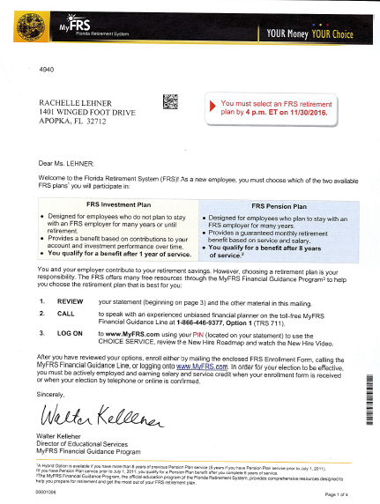
If you enroll in the State University System Optional Retirement Plan (SUSORP), you will continue to receive reminders (mailed to your home as well as emailed to you) from the Florida Retirement System (FRS) regarding the FRS enrollment.
You can simply disregard these reminders if you have already enrolled in the SUSORP.
Notes:
Please note that the date of hire that is listed on the letter that you receive from FRS is incorrect. The FRS bases your hire date on your first *contribution date*.

Slide 31
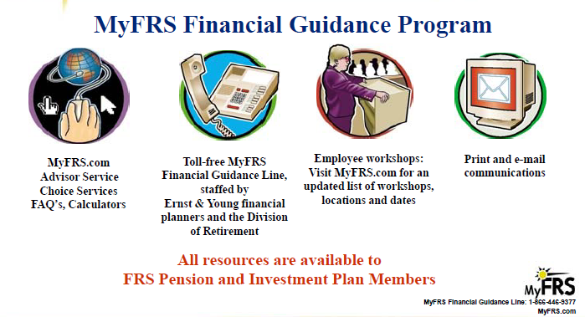
FRS Resources
MyFRS Financial Guidance Line: 1-866-446-9377
Website: MyFRS.com

Slide 32
Reemployed Retirees
If you are retired from the FRS Pension Plan (or DROP):
  You are not eligible for renewed membership in any State of Florida retirement plan (FRS Pension, FRS Investment and/or ORP Plan).
If you are retired from the FRS Investment Plan or SUSORP Plan:
  If you are a reemployed retiree returning to work in an ORP eligible position, you must enroll in the ORP plan.
  If you are a reemployed retiree returning to work in a non-ORP eligible position, you must enroll in the FRS Investment Plan.
Additional Reminders:
  If you are retired from the FRS Pension, FRS Investment or SUSORP retirement plans, a minimum of (6) full calendar months is required before you can be rehired.
  If you come back before the (6) month minimum, you will be financially liable for repayment if in violation.
  Monthly benefit/distribution will be suspended during months 7 through 12, if reemployed.

Slide 33
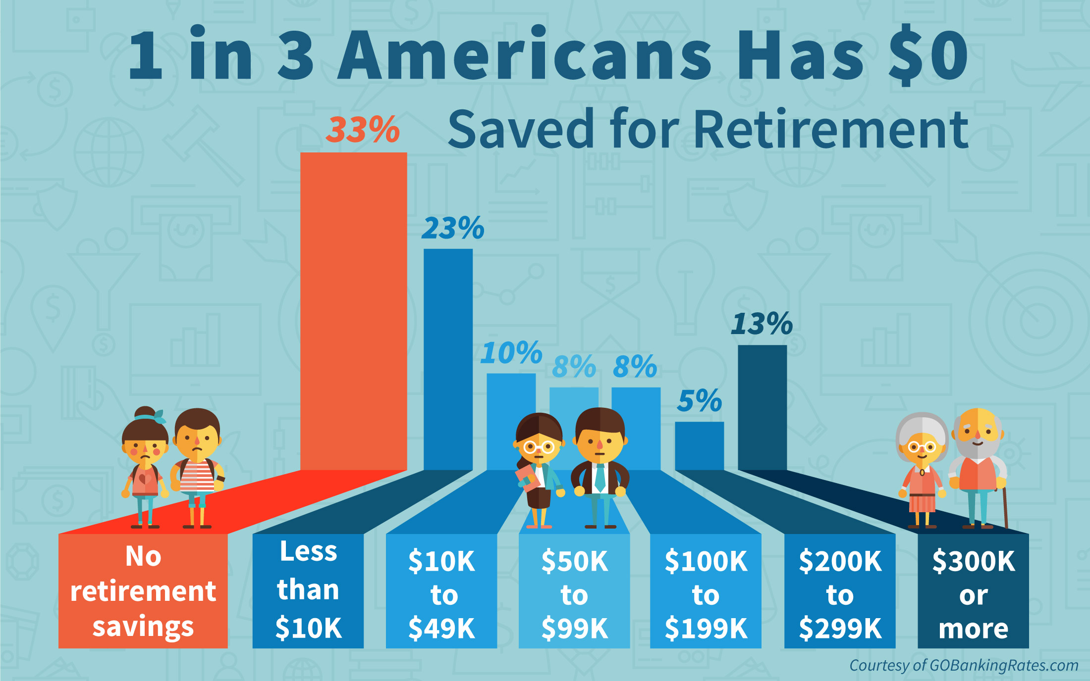
Importance of Saving for Retirement

Slide 34

The Benefit of Starting Early
The earlier that you start to save and invest, the more you’ll have when you retire.
Example Below: Salary = $35,000; 5% contribution rate = $67.31 bi-weekly
Beginning Age | Ending Age | Rate of Return | Savings Balance | Total
25 | 65 | 5% | $0 | $464,584
30 | 65 | 5% | $0 | $317,950
35 | 65 | 5% | $0 | $213,347
40 | 65 | 5% | $0 | $139,306
45 | 65 | 5% | $0 | $87,401
50 | 65 | 5% | $0 | $51,455
55 | 65 | 5% | $0 | $26,951
60 | 65 | 5% | $0 | $10,597

Slide 35
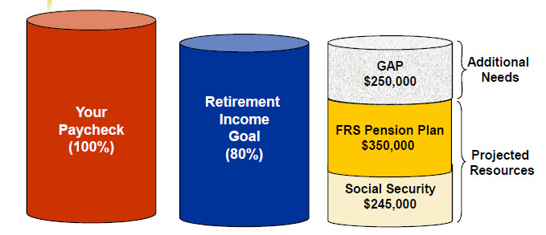
What is a “Pre-Tax Retirement Contribution”?
Voluntary, SUPPLEMENTAL income to fill the gap between your retirement income (pension/social security) and “income goal”
Additional Benefit: Reduces your tax liability while adding to your retirement savings
403(b)
457(b)
Considerations:
Benefits During Retirement
  Health Insurance: Current Retiree Annual Premium (Family Plan): $17,328.72
  *If eligible for Medicare, annual premium is $9,321.12
30%
41%
29%

Slide 36

Voluntary Retirement Options
Employees who wish to make voluntary contributions may do so through the following options:
Voluntary Contributions are in addition to FRS or SUSORP plans
UCF does not match voluntary employee contributions
Enrollment/Changes can be made at any time during the year
Pre-Tax Investments | Post-Tax Investments
403(b) 457 (b) | Roth 403(b)

Slide 37

How To Enroll In Voluntary Retirement Plans
Retirement Plan | Enrollment Deadline | How to Enroll
Voluntary 403(b) Plan (Pre-Tax & ROTH) Eligible: All employee classes including OPS. | No enrollment deadline – can enroll any time. | Open a voluntary retirement account with one of the three voluntary 403(b) companies: Fidelity TIAA VALIC *You can enroll online or by contacting a local representative. The online enrollment links and local contact information can be found here: http://hr.ucf.edu/current-employees/retirement/#retire1d. Complete the Salary Reduction Agreement (SRA) (http://hr.ucf.edu/files/SRA.pdf) Return the completed SRA to the Benefits Section via secure eFax (407-882-9022) or password protected email attachment (benefits@ucf.edu).
457 Deferred Compensation Eligible: All employee classes including OPS. | No enrollment deadline – can enroll any time. | Contact the State Office of Deferred Compensation: Telephone: (877) 299-8002 Website: www.myfloridadeferredcomp.com
2018 IRS Max
$18,500: Employees under age 50
$24,500: Employees age 50 and older

Slide 38

UCF 403(b) Plan Resources
CAPTRUST Retirement Counselors: 800-967-9948
Website: www.captrustadvice.com

Slide 39


The UCF Human Resources Benefits section now offers an insurance and retirement enrollment lab to assist employees in completing their insurance and retirement enrollments.
During these one-on-one sessions, key features of the benefits plans can be compared and issues can be addressed, which need to be considered when making election decisions.
Assistance With:
  People First Sign-In & Enrollment Process
  State Sponsored & Voluntary Retirement Plan Enrollment Process
  The Gabor Agency Supplemental Plans Enrollment Process
The sessions are available by appointment only. To make an appointment, please call or email the UCF Benefits section:
  Call: (407) 823-2771
  Email: Benefits@ucf.edu

Slide 40
Questions

