Slide 1
Welcome to the
HR Liaison Network Meeting
April 15, 2014

Slide 2
Welcome and Introduction
Building Partnerships
Collaborating Campus-Wide
Roxane Walton

Slide 3
Fairwinds Credit Union
Garry Capton
Vice President of University Partnerships

Slide 4
Guest Speaker
Building Partnerships
Collaborating Campus-Wide
Marvin Pyles -- Associate Vice President of Human Resources and CHRO

Slide 6
Team building Activity
“You can learn more about a person in an hour of play than you can from a lifetime of conversation" -Plato
Debbie Frankenbach

Slide 7
5 minutes to build a LEGO House
Each table has the SAME number of blocks
Your table has 5 minutes to build a LEGO house using ALL the blocks (if you want MORE feel free to come up front to get MORE!)
First team to build a house using all the blocks WINS!
READY – SET – GO !

Slide 8
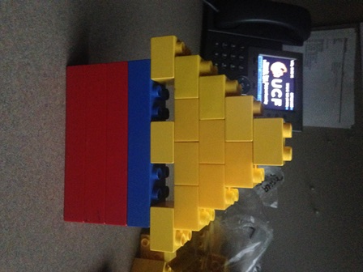
Need inspiration!

Slide 9
Announcements
OPS HealthCare Announcements are detailed below:
HR sent out OPS Eligibility reports this week via email notifying departments that have OPS employees currently identified as eligible for state benefits coverage. Going forward HR will continue to send departments an update if one of their employees is reported on the eligibility reports received from the state. The eligibility report is in addition to the OPS enrollment notification that is currently sent to the departments when one of their employees enrolls in benefits.
OPS Healthcare Implementation Updates section of the HR website has been updated to include a reference guide that details the determination of benefits eligibility for OPS employees and the state’s defined measurement periods.
Reminder: Questions regarding OPS healthcare or specific questions regarding your OPS employees eligibility can be directed to healthcarecompliance@ucf.edu

Slide 10
Announcements
PeopleSoft Split Project
Go Live Date is 07/07/2014
Coming soon will be important dates and information!
Be on the look out for information regarding early payroll processing and ePAF deadlines that will be affected by a shutdown of all forms pending the Go Live date.

Slide 11
Announcements
Leadercast UCF
May 9, 2014, Live Simulcast
UCF FAIRWINDS Alumni Center
8:30 am to 4:30 pm
http://hr.ucf.edu/leadercast/
$79 includes Dunkin Donuts breakfast, 4Rivers lunch, event, and gift
Limited amount of tickets – register today!

Slide 12
Announcements
Calling all UCF employees interested in Toastmasters!
A lunchtime Toastmaster's Club is starting at UCF on Tuesday, May 6th. The club will meet every Tuesday from 12 – 1 pm. Since it’s at noon, you are welcome to bring your lunch. Parking is free.
The group is limited to 20 members, and we would like to invite YOU.
The kickoff meeting is scheduled for Tuesday, May 6, 2014 in the Human Resources OD & Training room (3280 Progress Drive) at 12:00 pm. All are welcome - please email Beth Scheitzach at beth.scheitzach@ucf.edu if you plan on attending.
The first meeting will provide information about Toastmasters. This link is helpful to read before the kickoff meeting: http://www.toastmasters.org/Members/MembersFunctionalCategories/AboutTI/History.aspx
There are two fees per member; however, these fees do not have to be paid during the kickoff meeting:
• $20: one-time new member fee per person
• $42: 6 months' membership dues per person

Slide 13
Upcoming Dates
May 6th 12:00 to 1:00 p.m. – Toastmaster’s Information Session in HR
May 9th 8:30 to 4:30 p.m. – Leadercast UCF
July 7th PeopleSoft Split Go Live!
Future HR Liaison Network Meetings
July 15, 2014 T.B.A.
October 7, 2014 9:00 – 11:00 a.m. Cape Florida 316ABCD, Student Union
January 13, 2015 2:00 -- 4:00 p.m. Cape Florida 316ABCD, Student Union
April 14, 2015 8:30 – Noon – Key West Room 218ABCD, Student Union

